Slide 1

Activision Final Presentation
May 10, 2022
Case Team Lead: Rachna Gupta
Associate: Vineet Gangireddy
Analysts: Kevin Luo, David Aley, Lindsay Blocker, Omar Wahby

Slide 2
Agenda
Outline:
fPCA Follow-Up
DOTW Analysis
DOTS Analysis
Purchase Data Analysis
Takeaways
Goals
1
Segment players by clustering on
time series engagement data
2
Interpret clusters based on other specific metrics
3
Gain insights into general customer
behavior

Slide 3

Section Overview
 | DOTW We analyzed player behavior by week and game mode to find clusters. Additionally, we analyzed player retention, revenue, and evolution to interpret the clusters
 | DOTS We analyzed player behavior by season to find clusters. We considered retention of players, revenue of players, and other factors to interpet the clusters.
 | Purchase Data We were given data on user purchases over time divided by type of purchase. We analyzed this in conjunction with our DOTW and DOTS analysis and individually to interpret player purchase behavior.

Slide 4
fPCA Follow-up

Slide 5
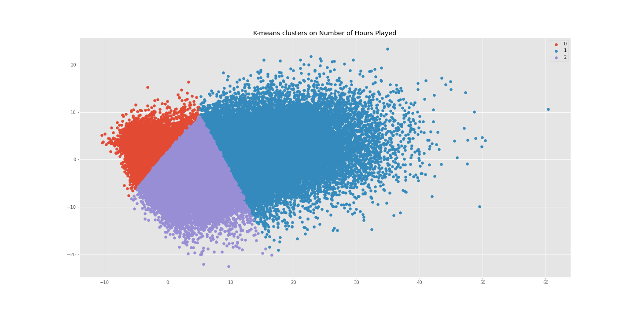
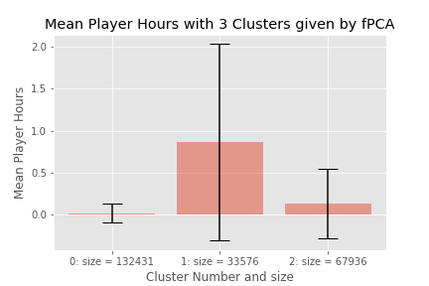
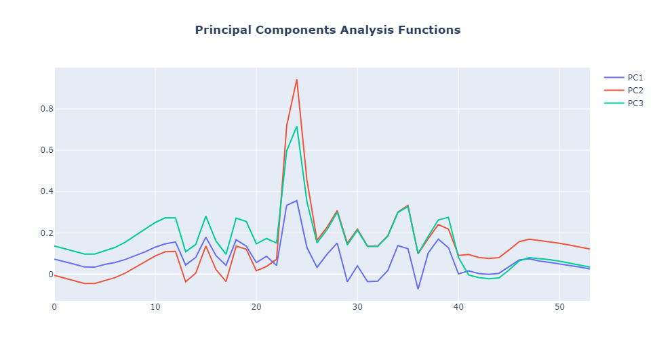
fPCA on Player Hours: Midpoint Results Review
Functional PCA analysis using 3 components was done initially on number of player hours for all players in 2022
The 3 cluster graph shows some separation, revealing potential underlying clusters
We found the mean player hours for the 3 clusters in the bottom right graph

Slide 6
fPCA Follow-up on Cluster Statistics
To understand the clusters given in the previous slide better, we consider mean, users, revenue generation, and hours played for each cluster
Cluster Number | Number of Users | Mean Hours Played (hr) | Standard Deviation (hr) | Revenue (USD) | Percent of Total Revenue | Number of Hours | Percent of Total Hours
0 | 132431 | 0.0128 | 0.111 | $8859.60 | 2.67% | 91314.34 | 4.32%
1 | 33576 | 0.861 | 1.171 | $277357.1 | 83.51% | 1560439.4 | 73.74%
2 | 67936 | 0.127 | 0.414 | $45913.44 | 13.83% | 464449.81 | 21.95%
From the statistics, we see that cluster 0 representing very little playtime corresponded also to a disproportionately small portion of the revenue. Cluster 2 representing a medium amount of playtime also corresponded to a disproportionately low percent of revenue in comparison to the number of users and number of hours they play. Finally, cluster 1 representing power users contributed to the vast majority of the revenue despite only being roughly 15% of total users and only 73% of total hours played.

Slide 7
Day of the Week Clusters

Slide 8
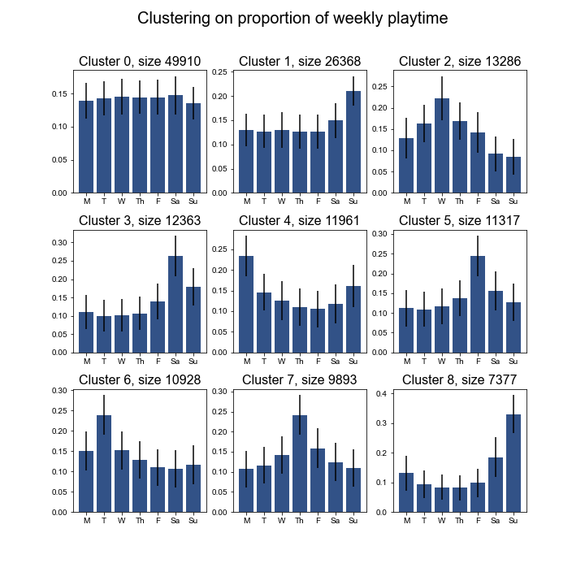
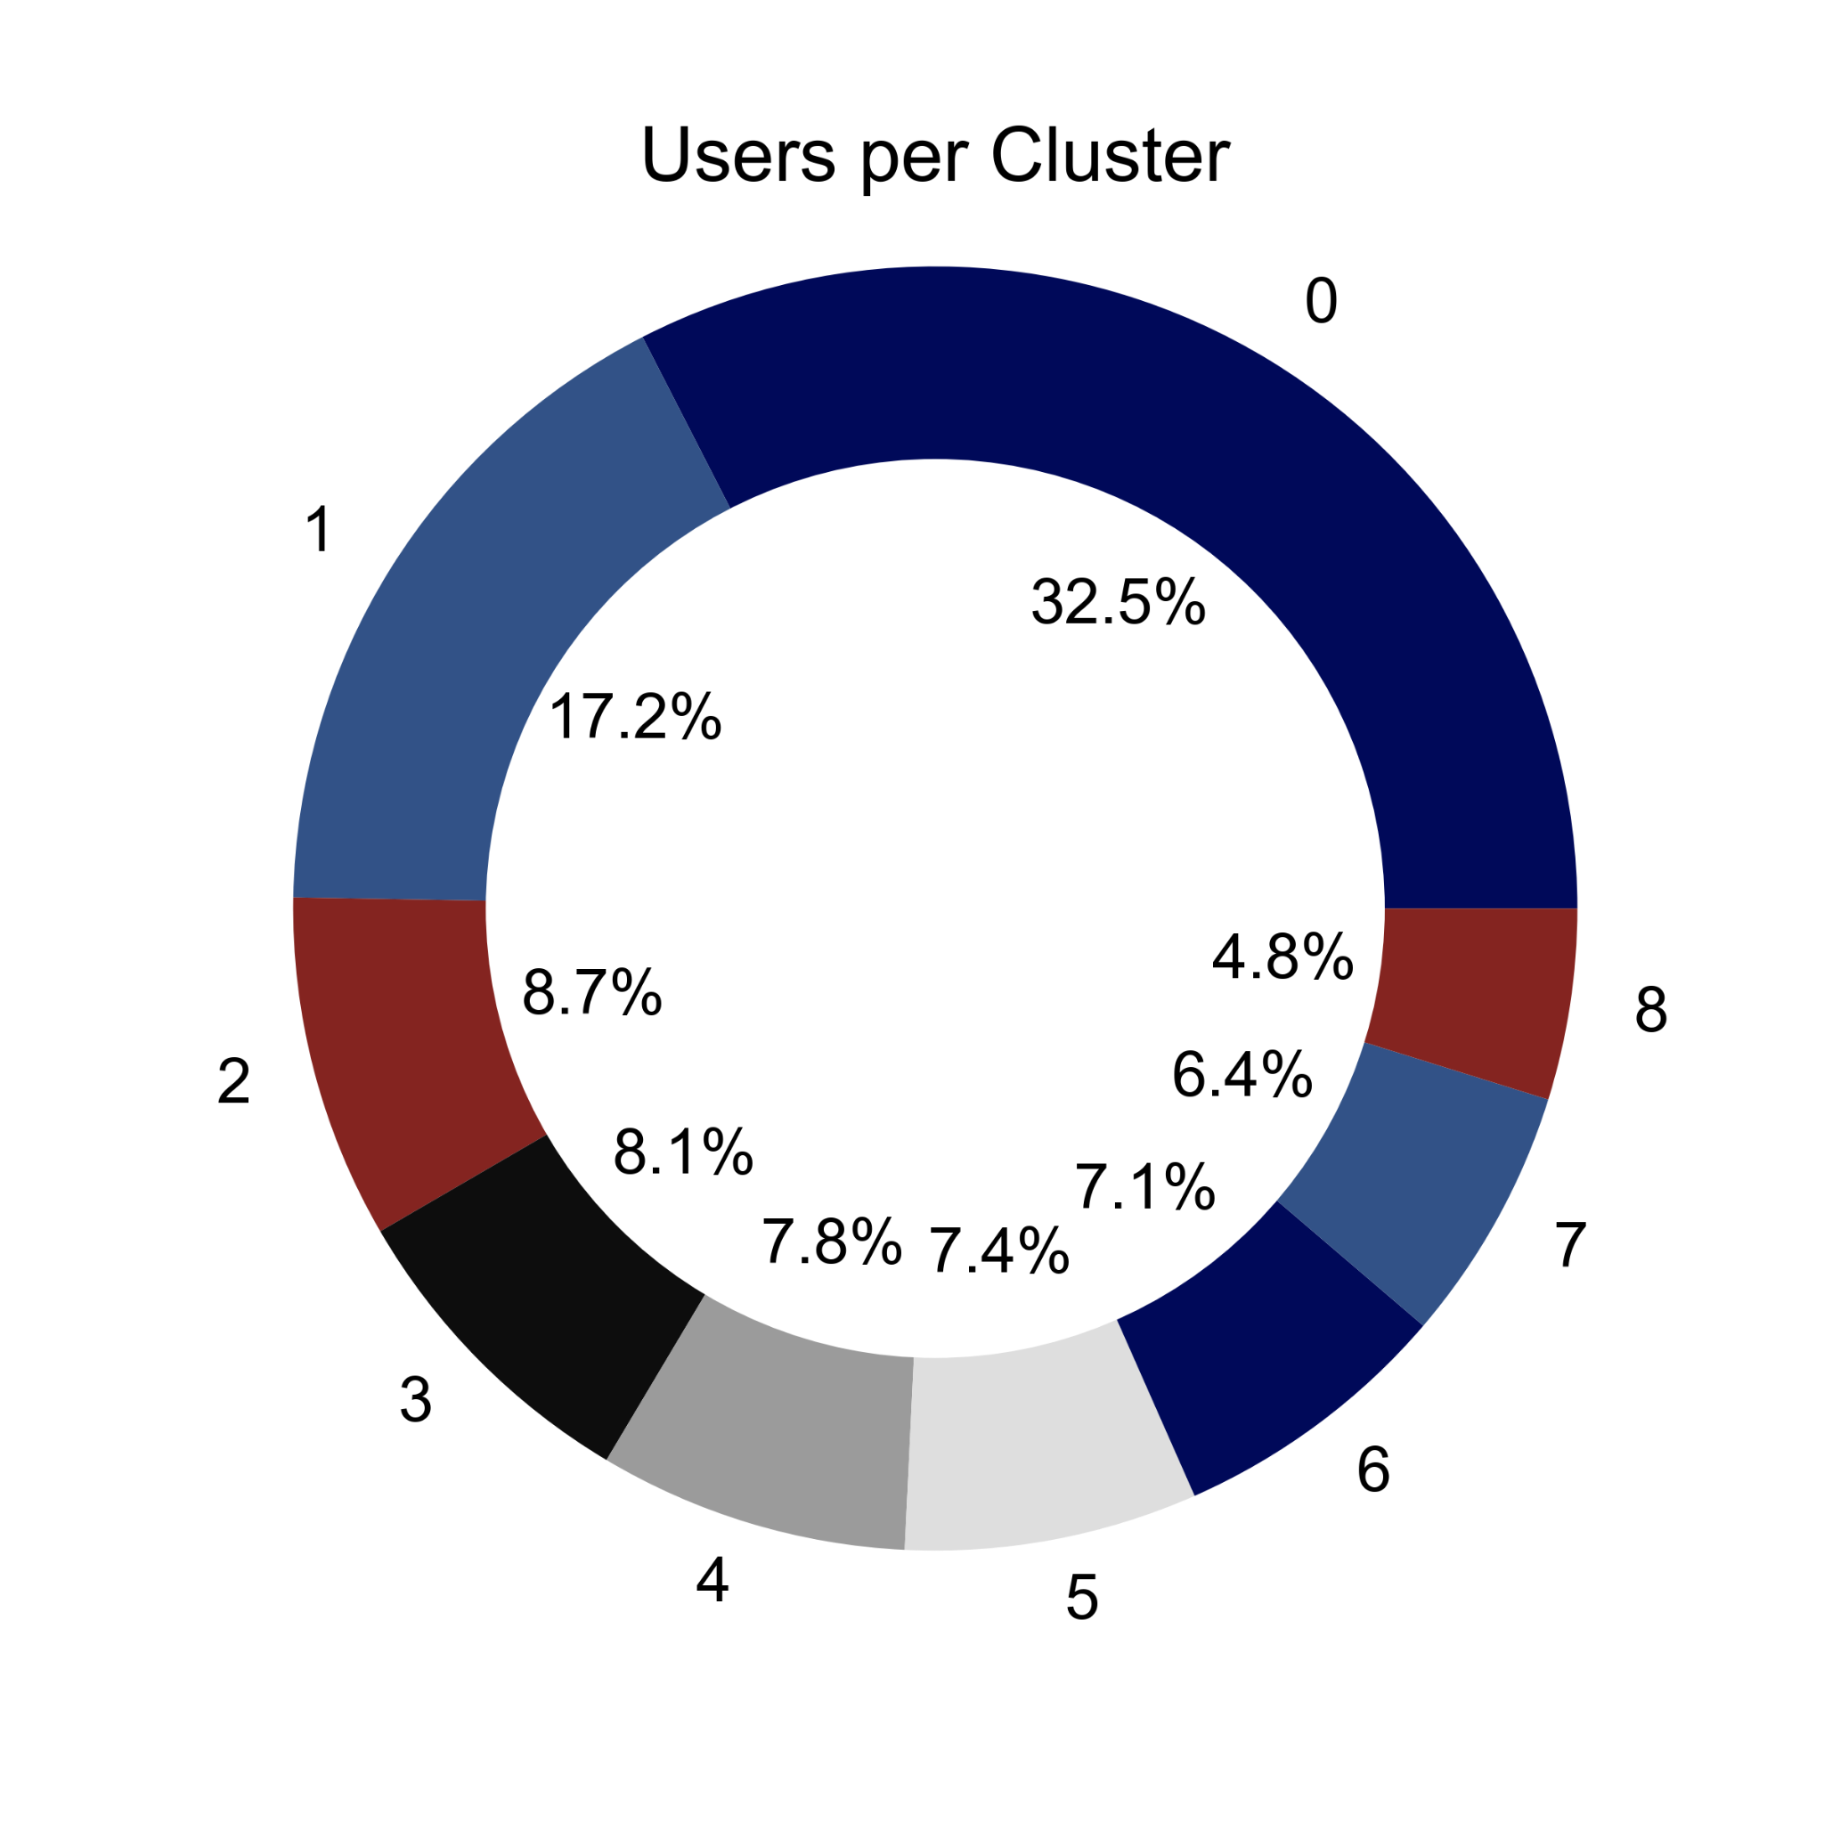
DOTW - Cluster Statistics
Recluster on 2021 + 2022 data
Same trends appear
Peaks are less noticeable, since averaging over more weeks means less users who play single weeks
Retrieved total engagement and revenues for each cluster of users
Notes:
As done last time, we cluster on the average playing profiles of the users. We see more or less the same patterns as before, where a majority of the players play either every day or the week days. The rest consist of smaller clusters of single day players,
The same caveats as before apply here, except for the fact that most of the people who’ve played for just 1 week and quit get dropped most of the time, because of how we are filtering.

Slide 9
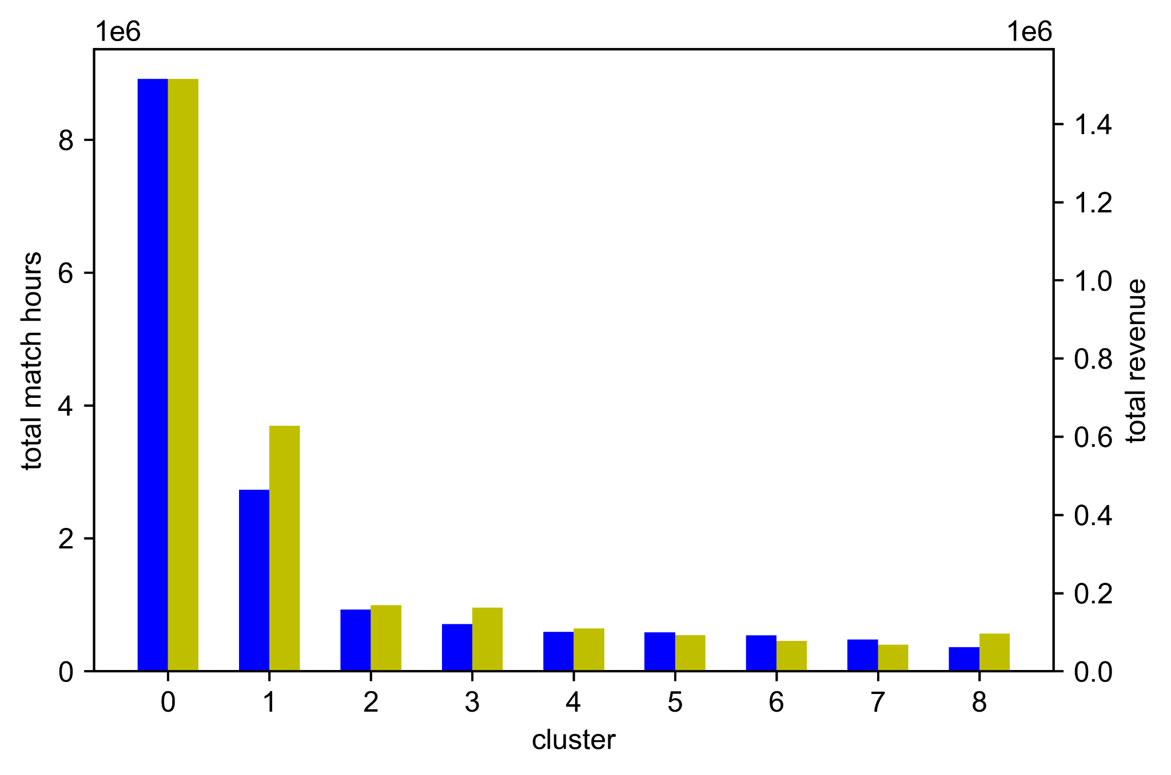
DOTW - Cluster Statistics
Gross User Revenue and Match Hours
Notes:
Cluster 0 has the highest revenue and playtime, followed by cluster 1. These are both clusters that represent more consistent play.

Slide 10
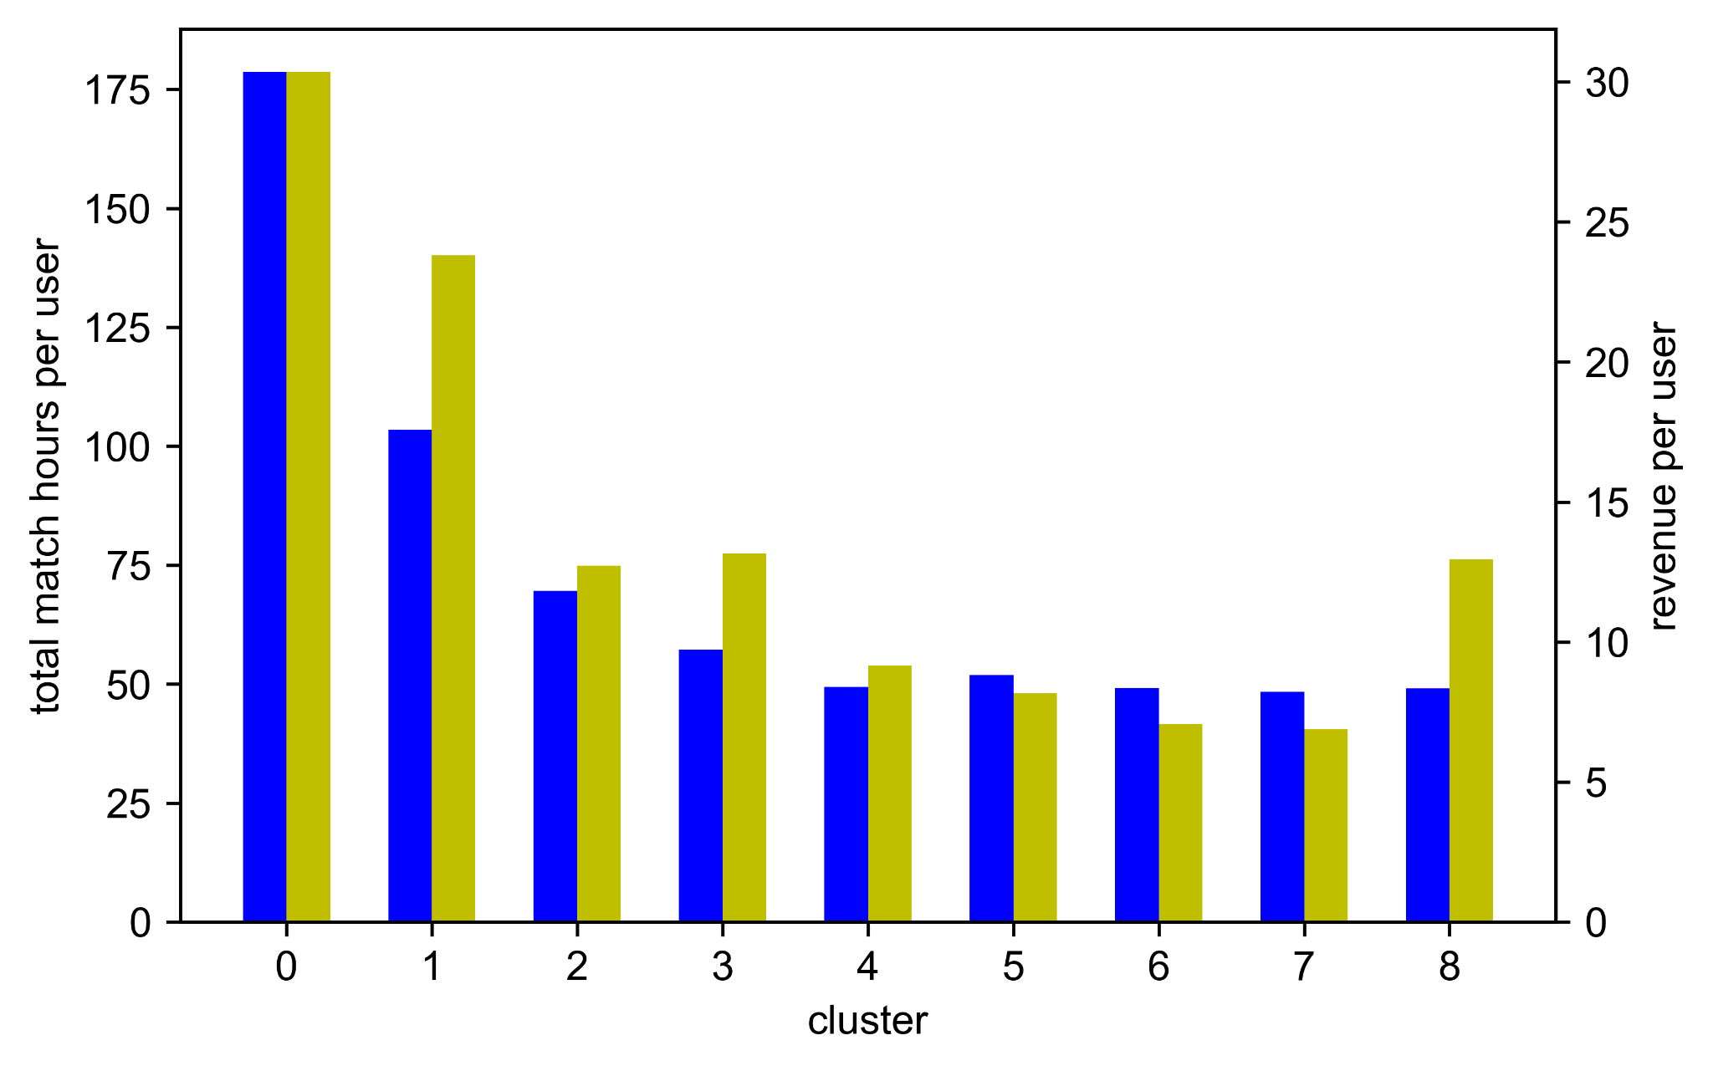
DOTW - Cluster Statistics
Per User Revenue and Match Hours
Notes:
Cluster 0 has the highest revenue and playtime, followed by cluster 1. These are both clusters that represent more consistent play.
Clusters 3 and 8 have higher per capita spending, and they correspond to the weekends. Perhaps shows some of the userbase is working?

Slide 11
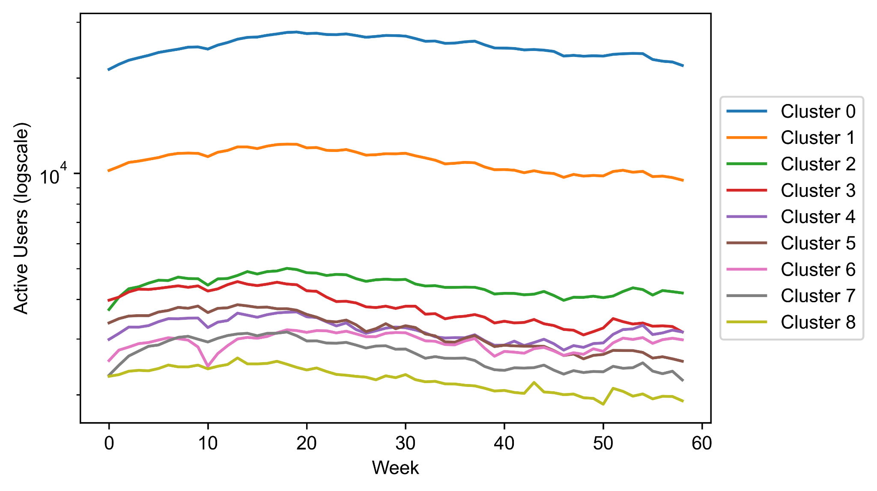
DOTW - Cluster Proportions
Active users change each week
Try visualizing how the proportions change
Generally consistent, dip is due to 3/16/21 not appearing in data
Notes:
So we tried looking into how the proportion of these clusters change. These rely on the classifications from earlier, but where we only look at the users who are active for a given week. There is a dip around week 10 for cluster 6. This is due to this anomaly in the data where 3/16 does not appear, don’t know if there was maintenance or something. That day was a tuesday, and the pink cluster is indeed the Tuesday cluster, which explains why the dip here is stronger than on other clusters.

Slide 12
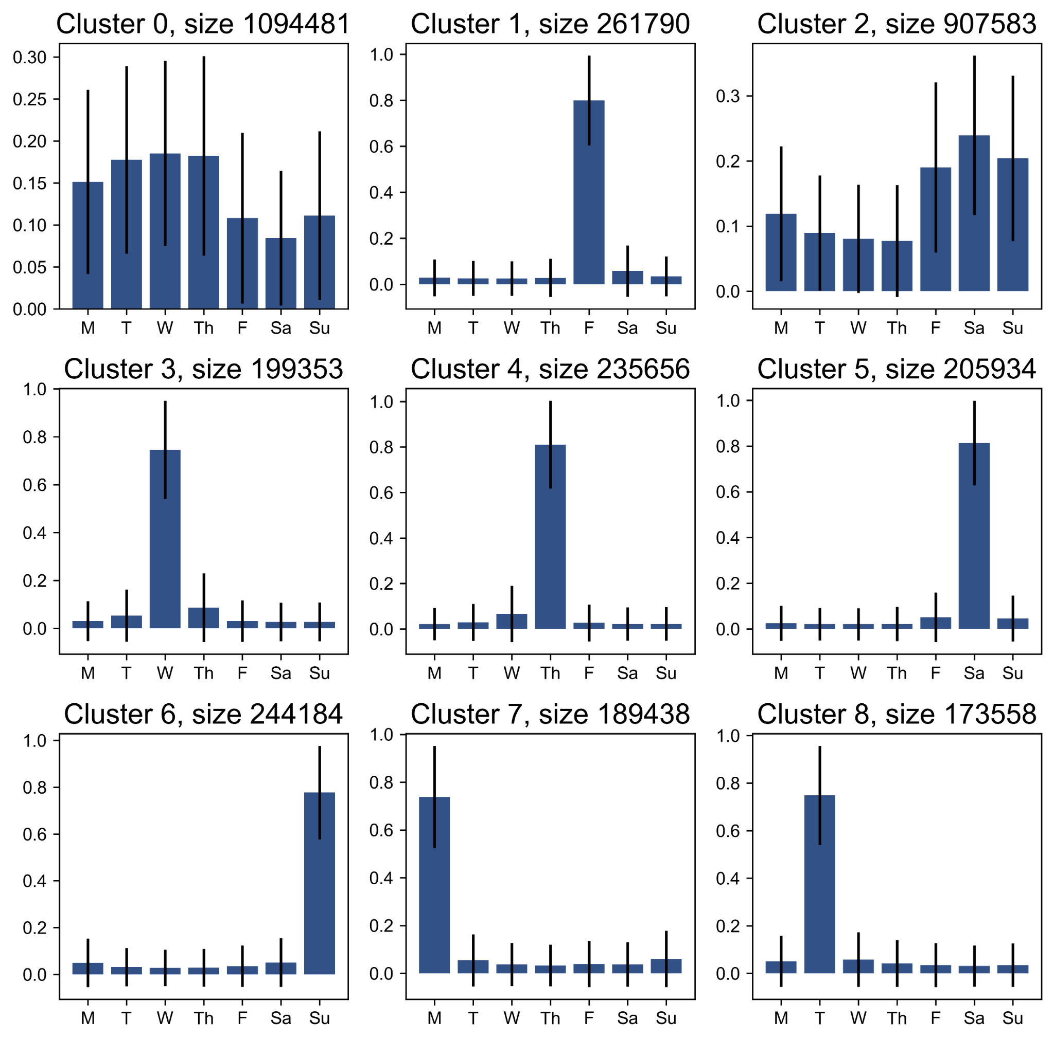
DOTW - Clustering over User-Weeks
Same chunk of users
Cluster over every user-week pair, to see how classification changes over time
Larger differences re-emerge due to presence of people playing single days once more

Slide 13
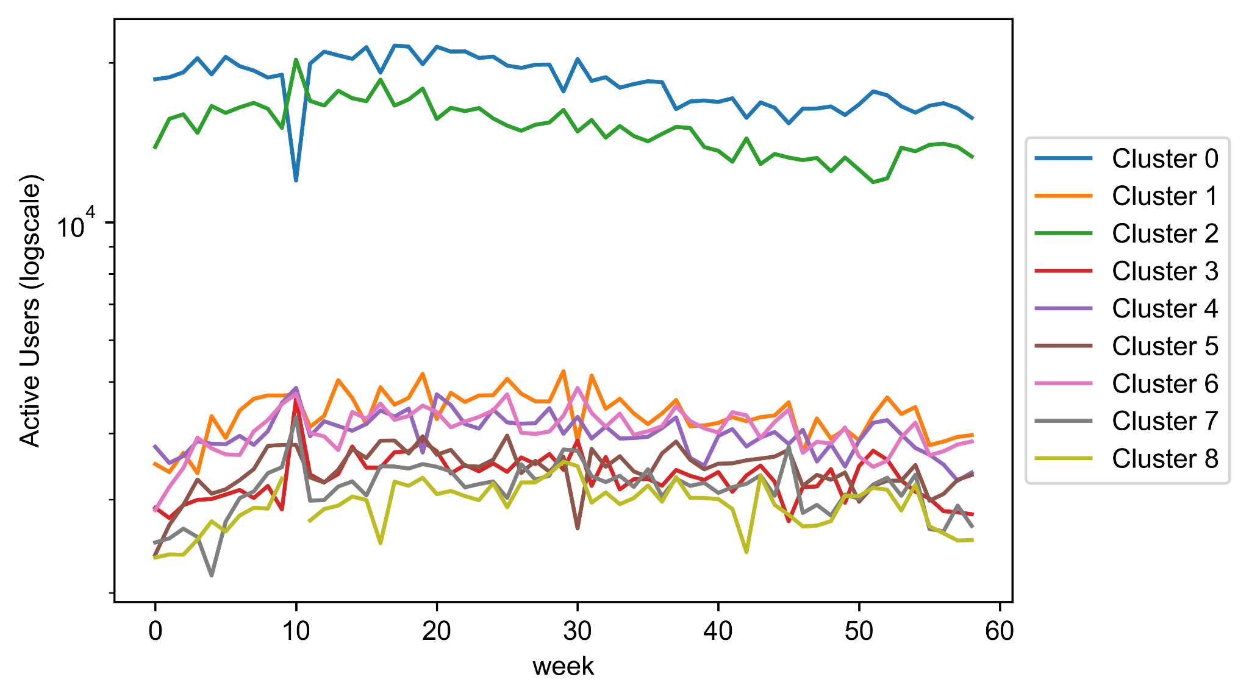
DOTW - Cluster Proportions
Cluster proportions again remain relatively consistent, but higher variability than before
Same dip appears

Slide 14
DOTW - Transitions
-1 cluster indicates inactive
Average proportion of user transitions
Row is starting state, column is ending state
Probabilities in first column indicates most exiting users are single-day players
 | -1 | 0 | 1 | 2 | 3 | 4 | 5 | 6 | 7 | 8
-1 | 0.902 | 0.016 | 0.007 | 0.007 | 0.012 | 0.018 | 0.008 | 0.011 | 0.009 | 0.01
0 | 0.027 | 0.437 | 0.056 | 0.337 | 0.022 | 0.022 | 0.025 | 0.027 | 0.025 | 0.021
1 | 0.39 | 0.128 | 0.066 | 0.085 | 0.054 | 0.063 | 0.055 | 0.059 | 0.05 | 0.049
2 | 0.081 | 0.339 | 0.054 | 0.316 | 0.029 | 0.033 | 0.041 | 0.048 | 0.032 | 0.028
3 | 0.227 | 0.188 | 0.089 | 0.161 | 0.055 | 0.055 | 0.059 | 0.062 | 0.053 | 0.051
4 | 0.159 | 0.217 | 0.115 | 0.228 | 0.042 | 0.046 | 0.056 | 0.052 | 0.044 | 0.04
5 | 0.391 | 0.101 | 0.058 | 0.093 | 0.051 | 0.058 | 0.075 | 0.078 | 0.05 | 0.046
6 | 0.335 | 0.118 | 0.055 | 0.119 | 0.047 | 0.053 | 0.069 | 0.104 | 0.054 | 0.046
7 | 0.31 | 0.147 | 0.066 | 0.11 | 0.055 | 0.06 | 0.059 | 0.073 | 0.065 | 0.054
8 | 0.285 | 0.161 | 0.074 | 0.12 | 0.057 | 0.06 | 0.06 | 0.067 | 0.059 | 0.059

Slide 15
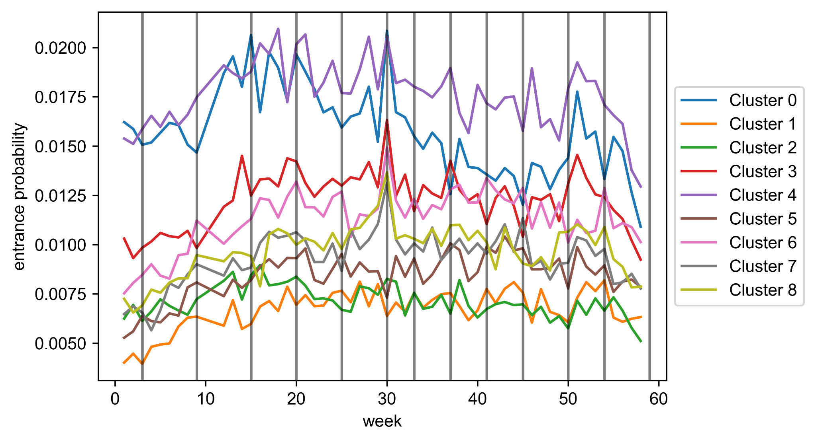
DOTW - Entering Active Users
Entrance proportions plotted over weeks
Vertical lines = season start
Can explain some spikes
Cluster 4 = Thursday Users

Slide 16
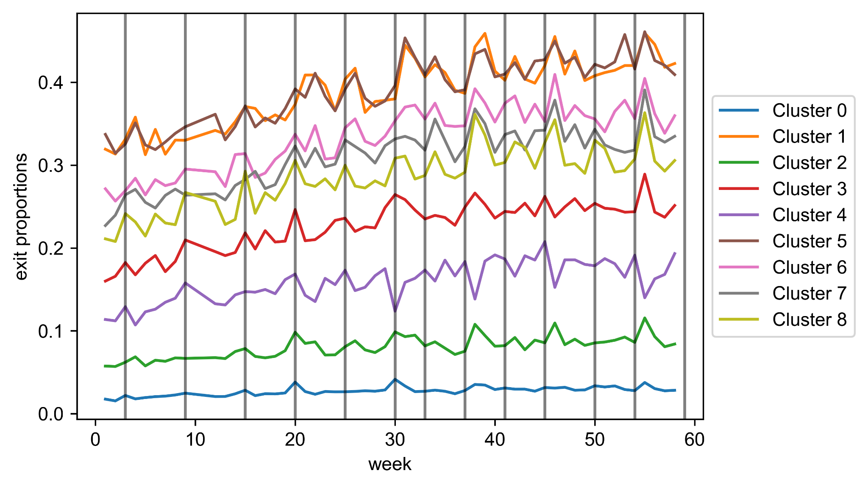
DOTW - Exiting Active Users
Exit proportions plotted over weeks
Some spikes occur 1 week after season start, esp for Clusters 0, 2
These contain the bulk of users
Clusters 1, 7 are Friday and Monday

Slide 17
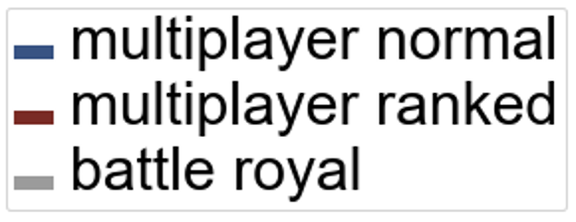
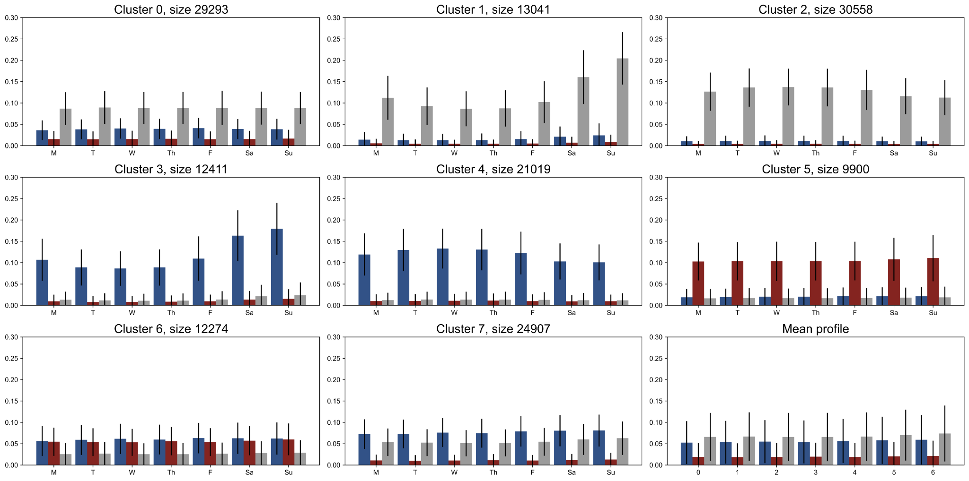
Game Mode DOTW - Cluster Statistics
Notes:
We also ran kmeans on the playtime in individual gamemodes.
Same preprocessing as before: dropping people who play less than 15 minutes per average week
Cluster count selection is a bit less clear - elbow is not well defined
Clusters less clear - peaks no longer exist - likely due to loss of single-week players
Suffers from the same caveats as before - aggregation loses long term trends
See clusters of weekend/nonweekend players of each gamemode (1, 2 = BR, 3, 4 = MPN, 5, 6 = more MPR, rest more mean-like)
Mpr is the odd one out - seem to have people who play more and more of it - perhaps climbers?

Slide 18
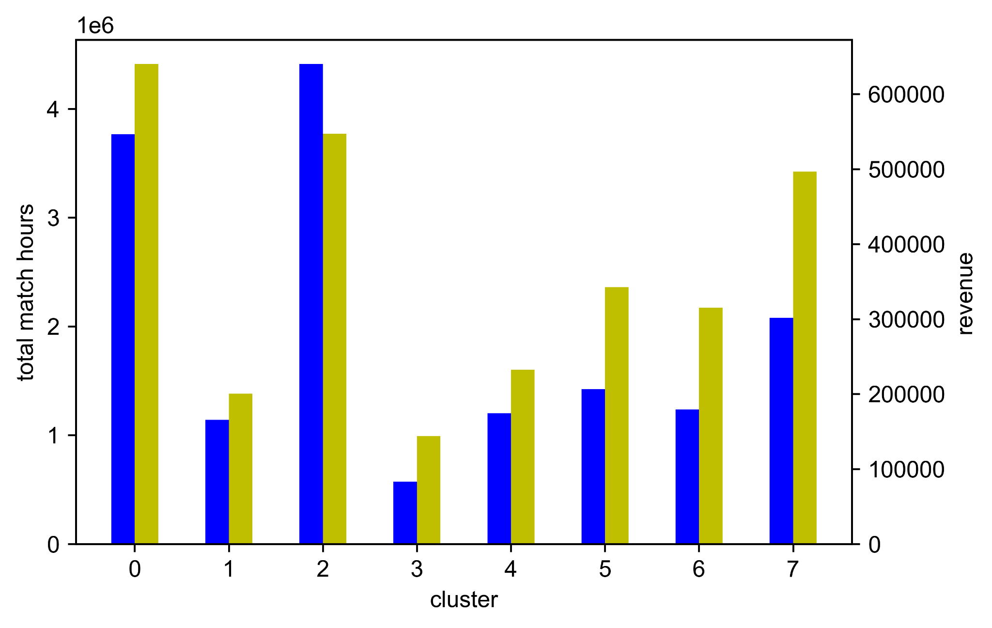
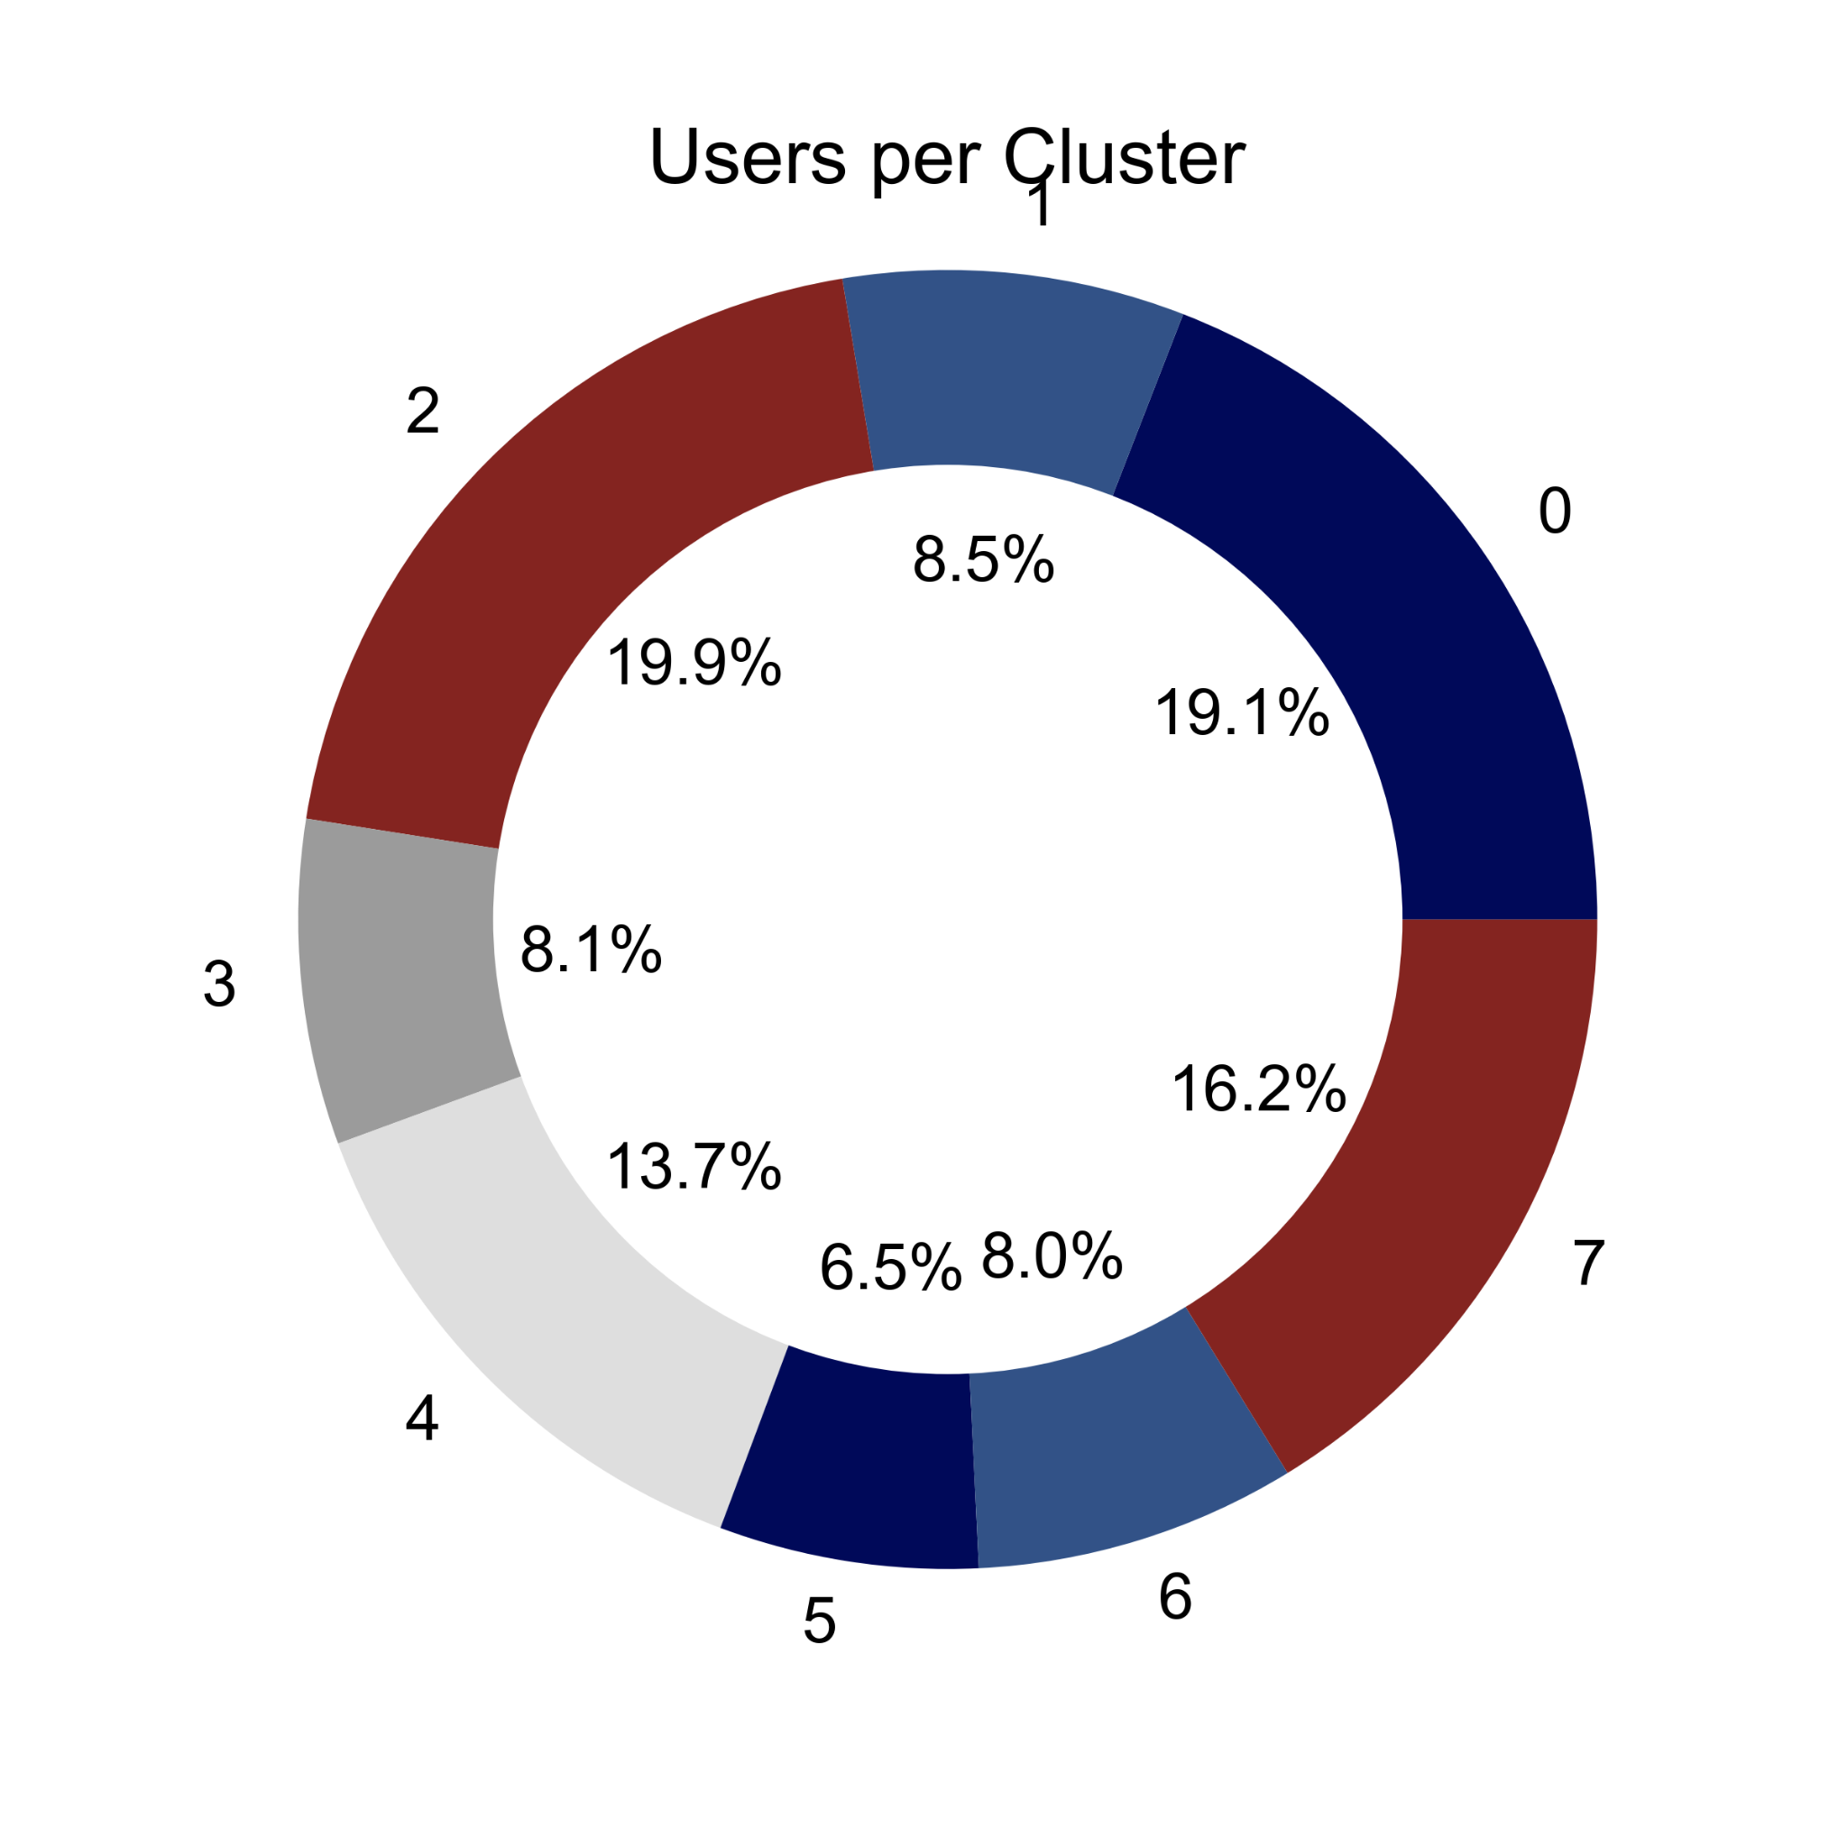
Game Mode DOTW - Cluster Statistics
Gross revenue and match hours per cluster
Gross Revenue and Match Hours
Notes:
Most gross revenue in clusters 0, 2, 7, but again these have higher user counts in general.

Slide 19
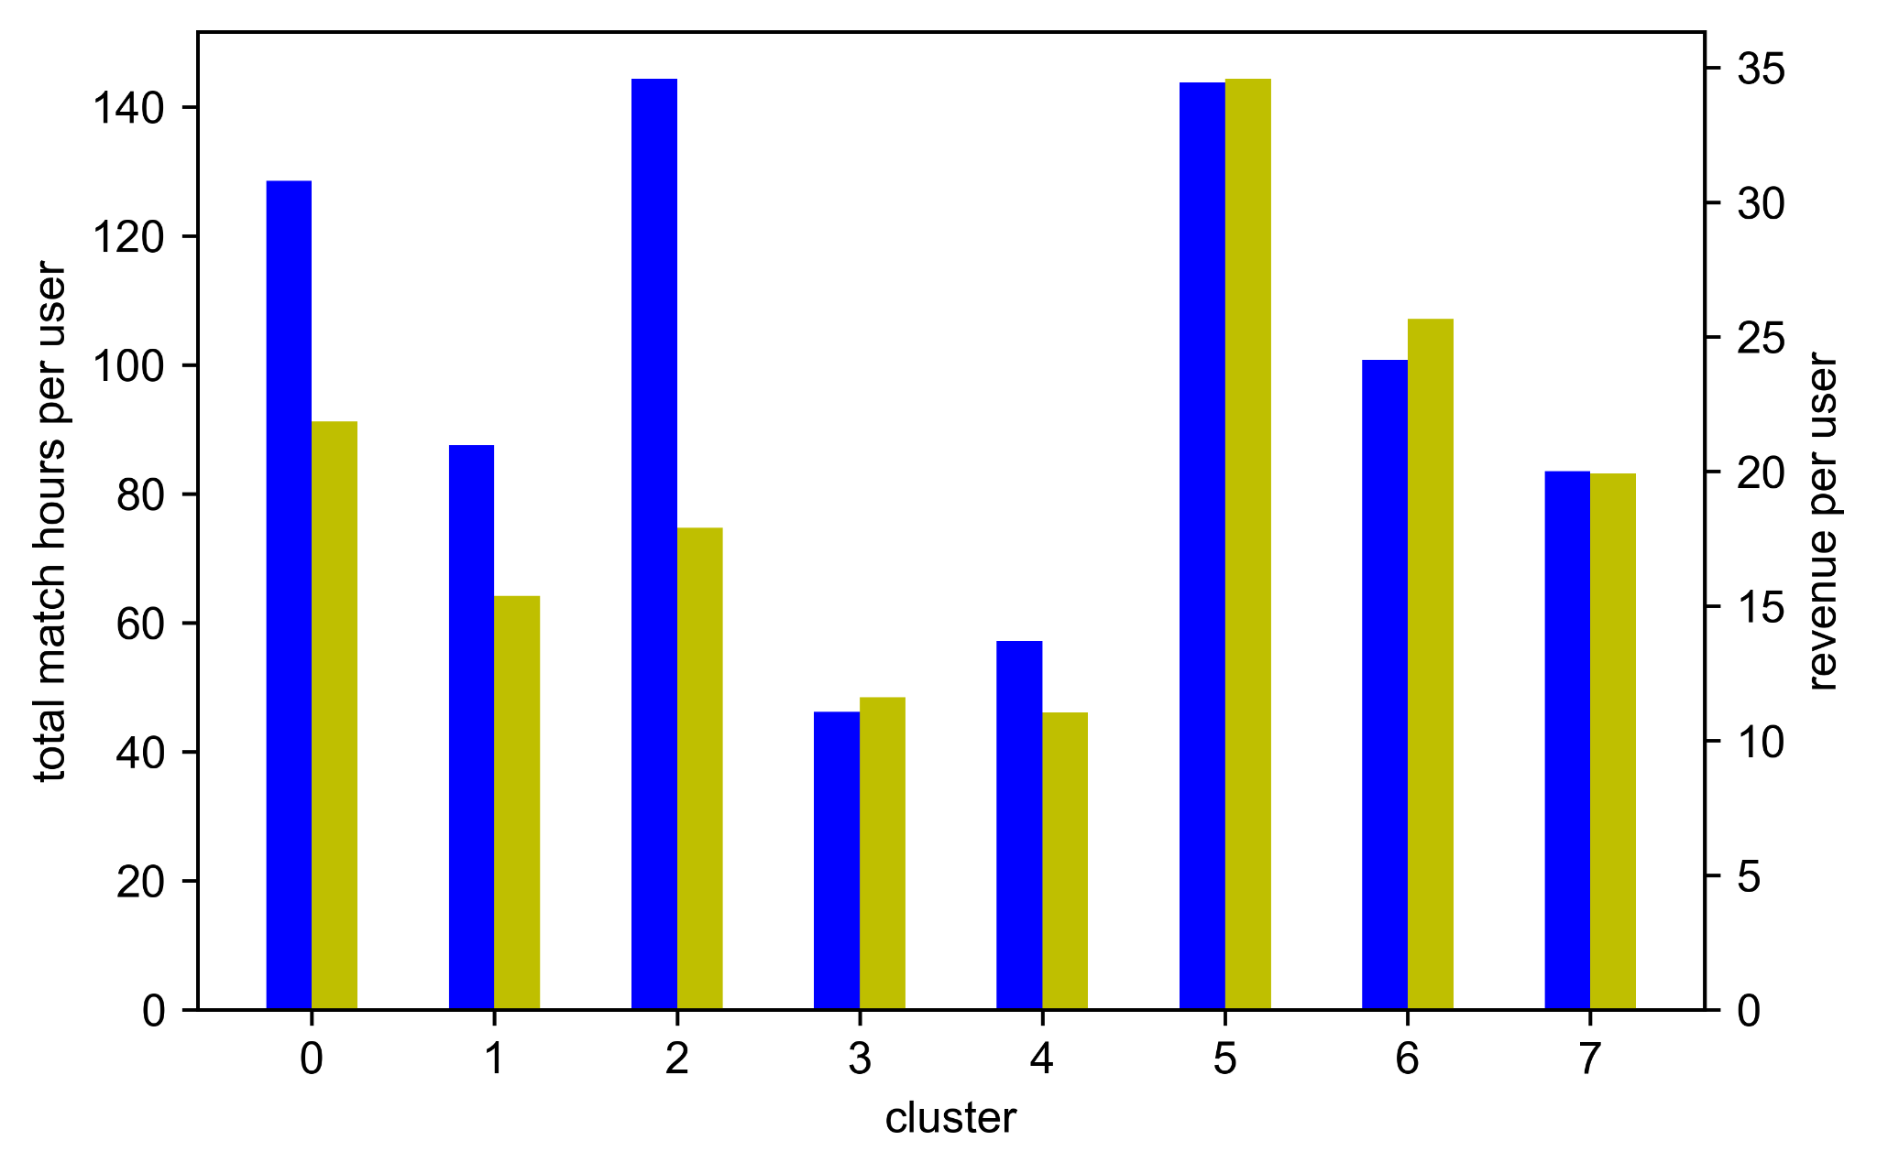
Game Mode DOTW - Cluster Statistics
Gross revenue and match hours for each cluster per user
Highest revenue clusters correspond to higher playtime in ranked modes, especially in cluster 5
Per User Revenue and Match Hours
Notes:
Normalizing out, we see that cluster 5 has the highest spend. These correspond to higher playtime in ranked modes, indicating perhaps a more competitive nature?

Slide 20
Day of the Season Clusters

Slide 21
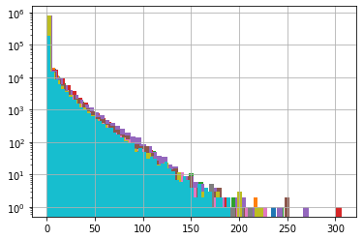
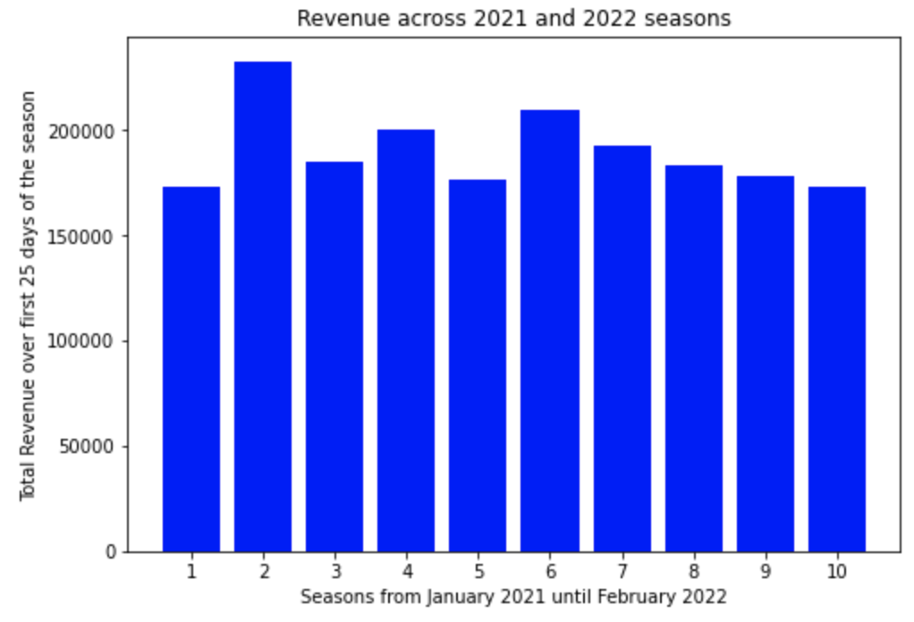
Day of the Season Clustering (1)
Irregular season lengths—decided to look at first 25 days of each season in 2021, 2022
Partitioned data by first 25 days of each season
Dropped some days toward the end of each season in order to compare every season
Histogram created, along with bar graph, to show similar distribution of player game time (in hours) over the course of all seasons
Histogram and bar graph of game time (in hours) for seasons in 2021, 2022

Slide 22
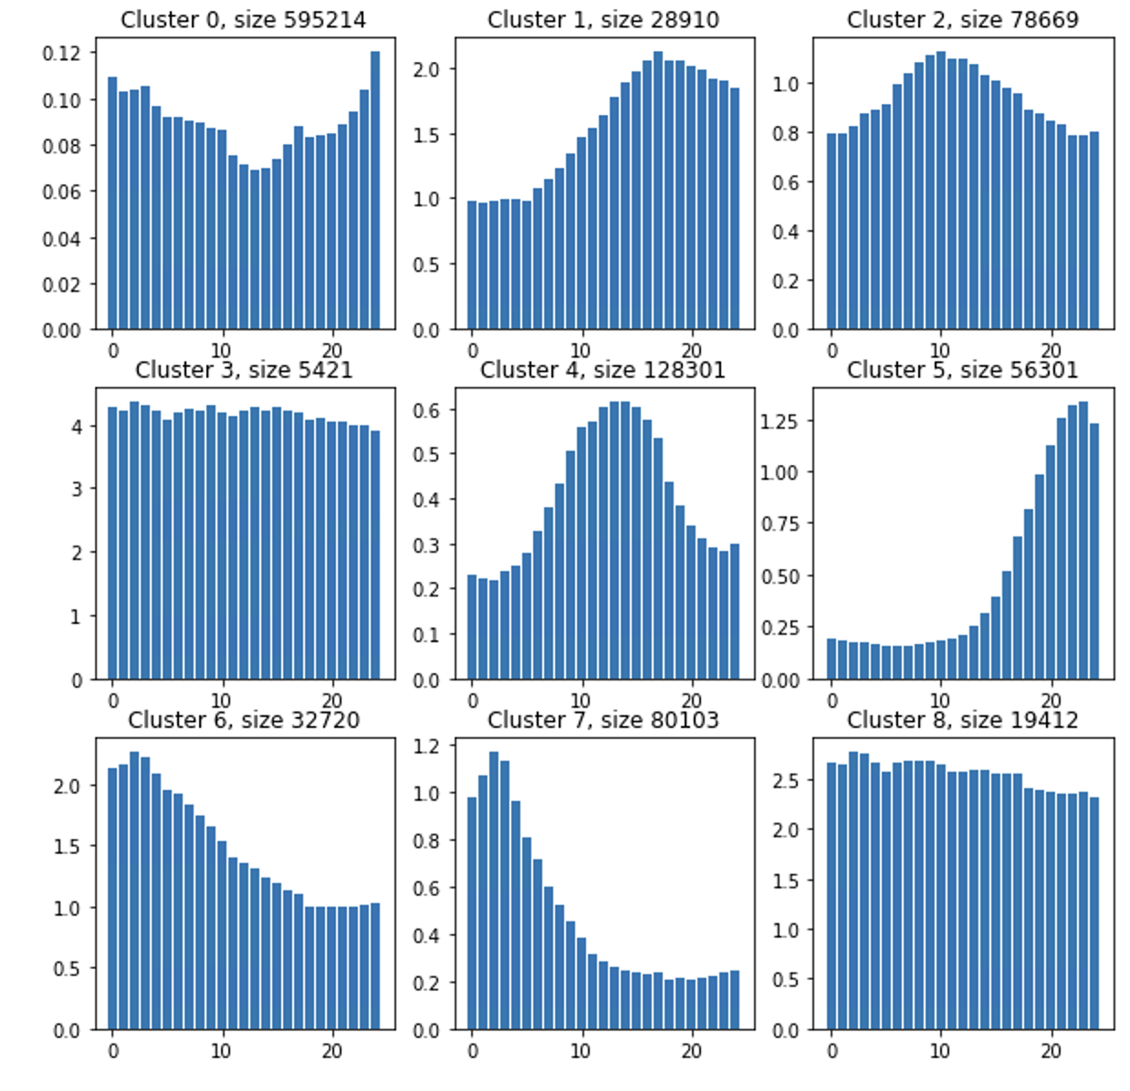
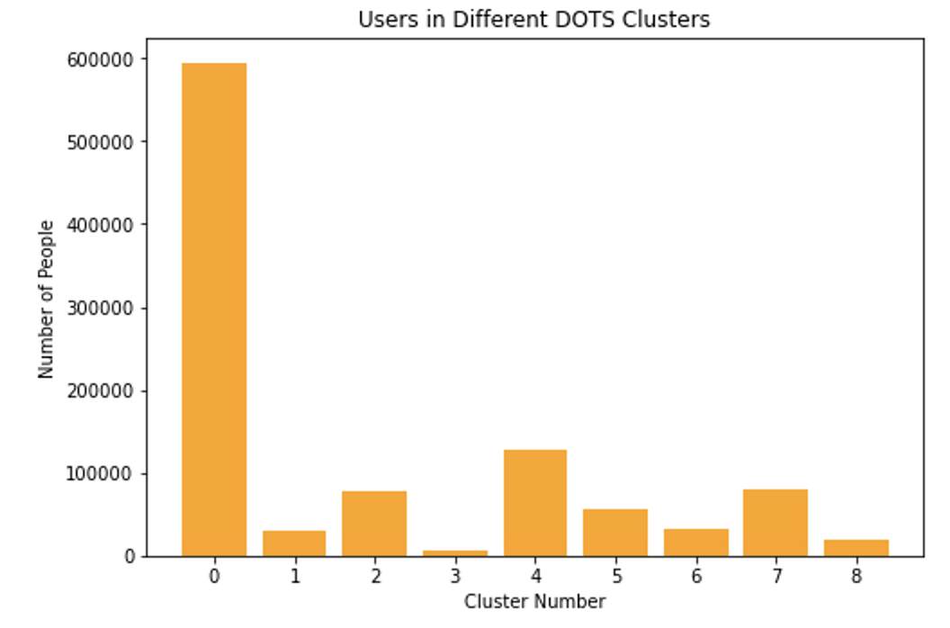
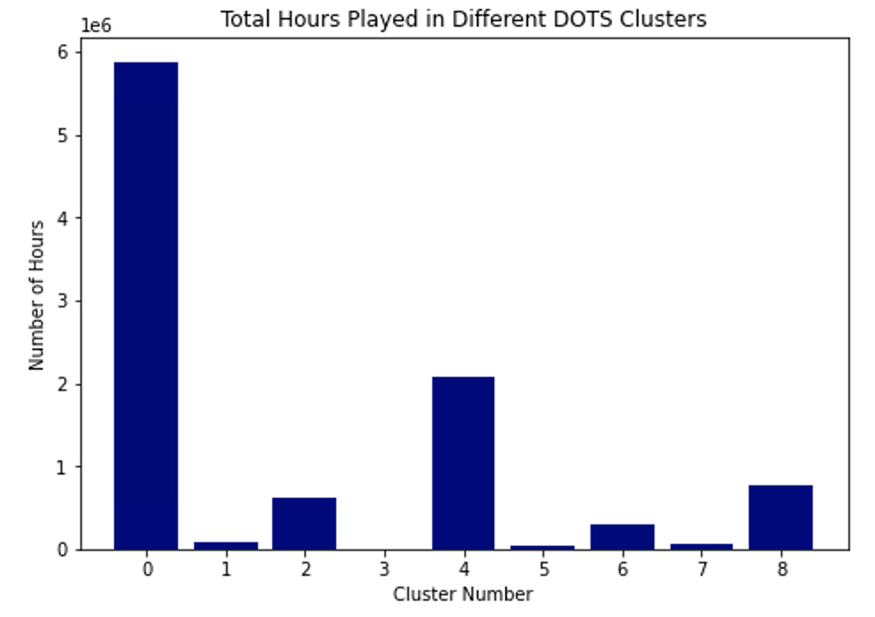
Day of the Season Clustering (2)
Nine clusters created from seasonal data
Note: cluster have different scales and different number of users
Dropped users with < 0.5 hours of gameplay over a season
Concatenated season dataframes, calculated inertias (model performance)
Cluster 0 and 4 contain the most users and total playing time
Clusters 2 and 8 highlight a somewhat constant trend over the season, yet contain fewer users and playing time
More complex questions we sought to address:
Account for users who only played for a small portion of the season?
Account for users who only played one season?
Clustering based on proportion of playing time for each day of the season
Notes:
The actual clusters themselves highlight groupings of different players over the course of each season, with the x-axis showing each day of the season and the y-axis representing play time (in hours). Each cluster has different sizes, but they all highlight various trends in the data over the course of each season.

Slide 23
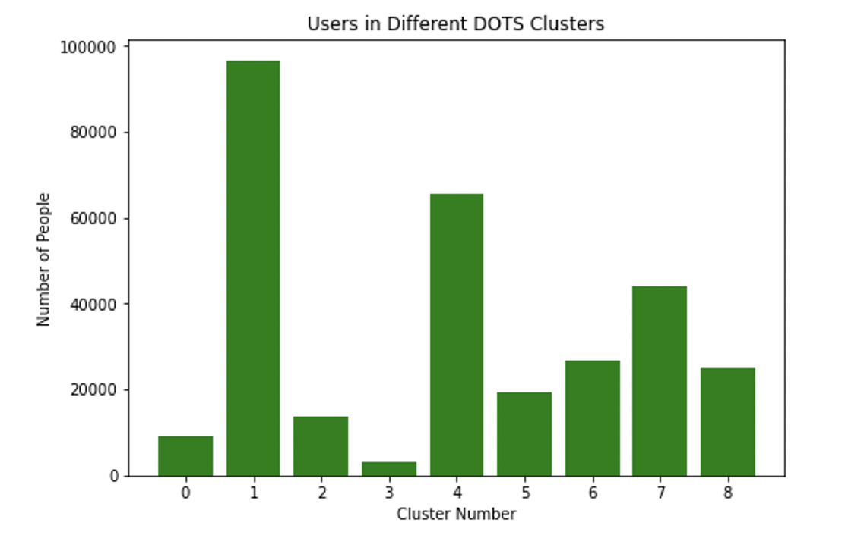
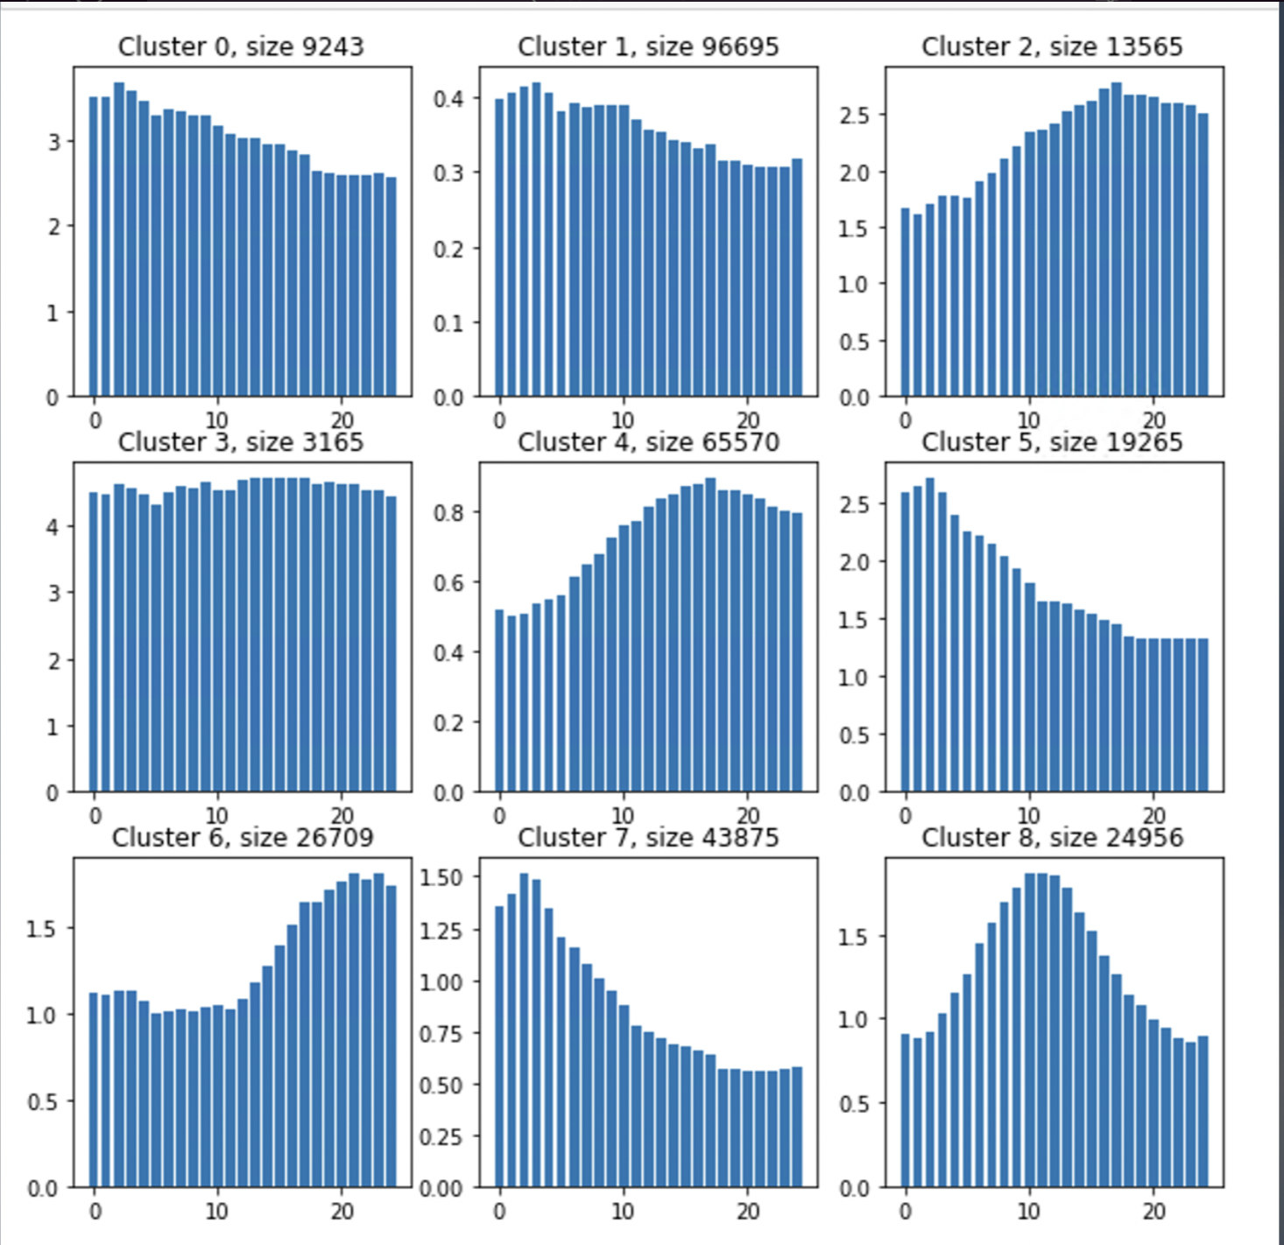
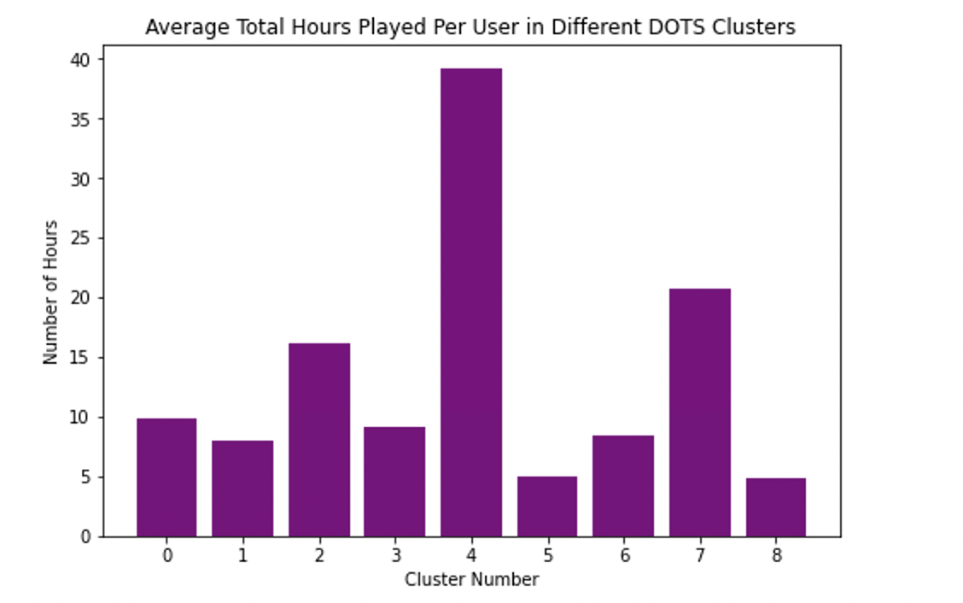
Day of the Season Clustering - Consistent Seasonal Players
Clustering based on proportion of playing time for each day of the season (only including users who played more than 15 days in a season)
Dropped users that played < 15 days in a season
Cluster 2,4,6 show players play more as the season progresses. Cluster 4 logs the most hours per user
Cluster 5, 7 show a significant number of users logging more hours at the start of a season
Cluster 8 show players who steeply peak in the middle of a season, but lower average hours
Most seasonally retained players (Cluster 4) increase their playtime across a season.
Notes:
For substantially large clusters like cluster 8, it is interesting to see a peak in playing hours in the middle of the season. it would be interesting to investigate further into that cluster of players. Cluster 1 play for a high number of hours per day but average time per player is much lower

Slide 24
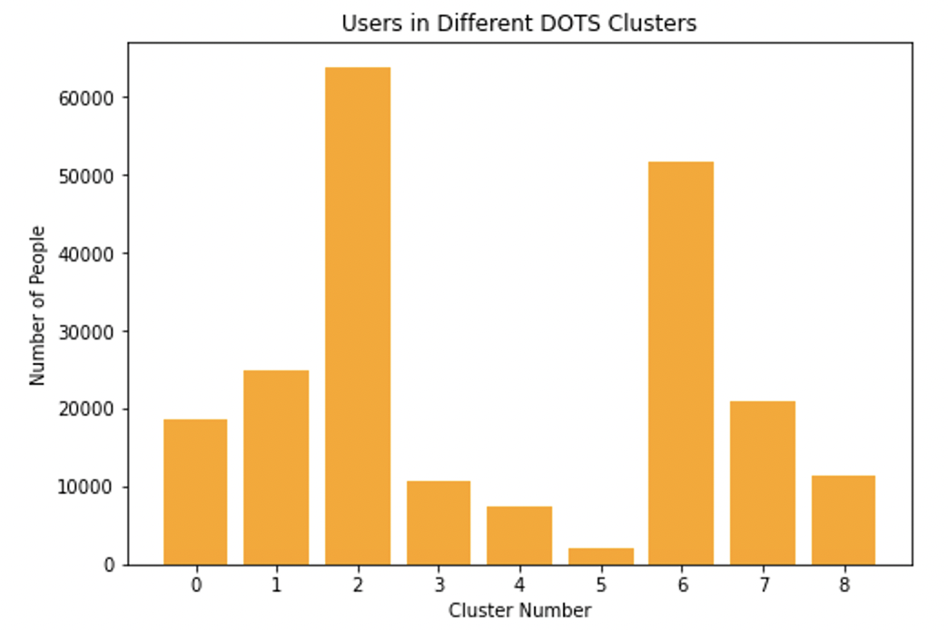
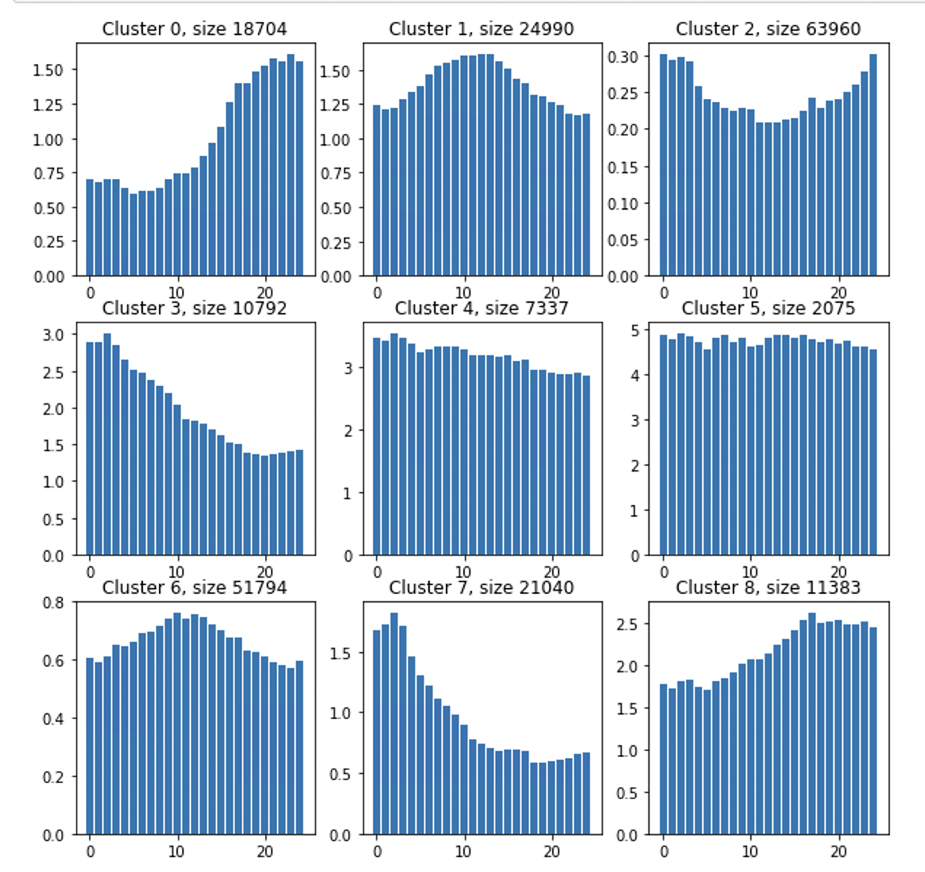
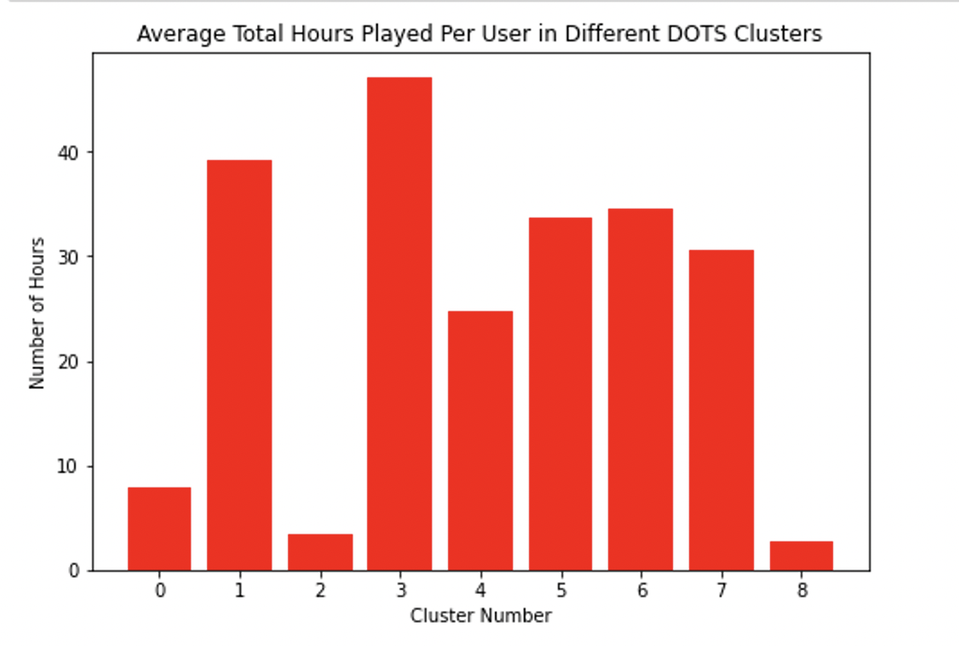
Day of the Season Clustering - Consistent Year-Round Players
Dropped users that played < 180 days
Surprisingly large subset of users given the large constraint
Clusters 0, 8 show increase as season progresses, but lower average hours
Cluster 3 and 7 log many hours per user but decline over the season
Clusters 1 and 6 peak in the middle of the season
The most consistent and active players play the most in the first 10 days
The most consistent but less active players play more near the end.
Clustering based on proportion of playing time for each day of the season (only including users who played more than 180 days in a year)
Notes:
If we look at players who participated in multiple seasons, do we usually see them behave similarly from season to season, or very different?

Slide 25
Purchase Data Analysis

Slide 26
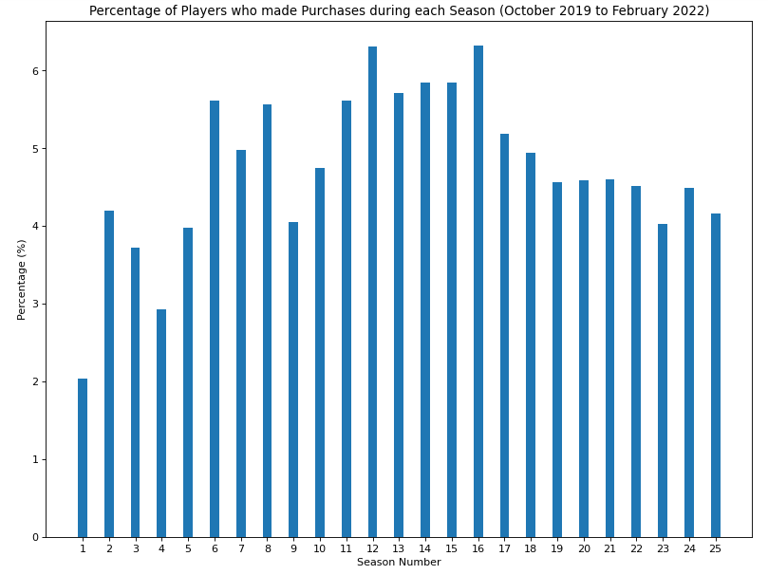
Descriptive Stats for Season Purchases from 2019 to 2022
Just after the extra RAM was added to our Virtual Machines, we were able to analyze all of the player purchases data by season from 2019 to 2022.
In the midpoint, we analyzed long-term trends through fPCA
Now, we will analyze purchase data by item type using the additional dataset provided via DOTW and DOTS k-means clustering

Slide 27
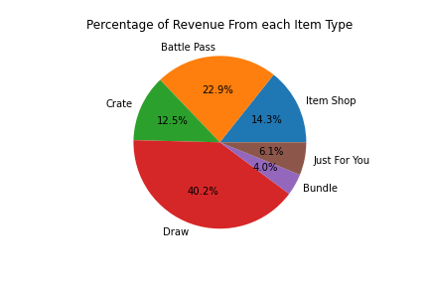
Player Purchase Breakdown by Type for 2019-2022
Item Type | Number of Transactions | Average Revenue per Transaction
Lucky Draw | 527229 | $4.17
Battle Pass | 228274 | $9.86
Crate | 158983 | $12.29
Just For You | 104823 | $19.09
Item Shop | 166164 | $10.51
Bundle | 21127 | $77.48
We see that Lucky Draw is the most popular item with close to half the transactions and around 40% of total revenue, even though it is the cheapest item. The more expensive the item, the lower the percentage of revenue it produces, because of the reduced number of transactions.

Slide 28
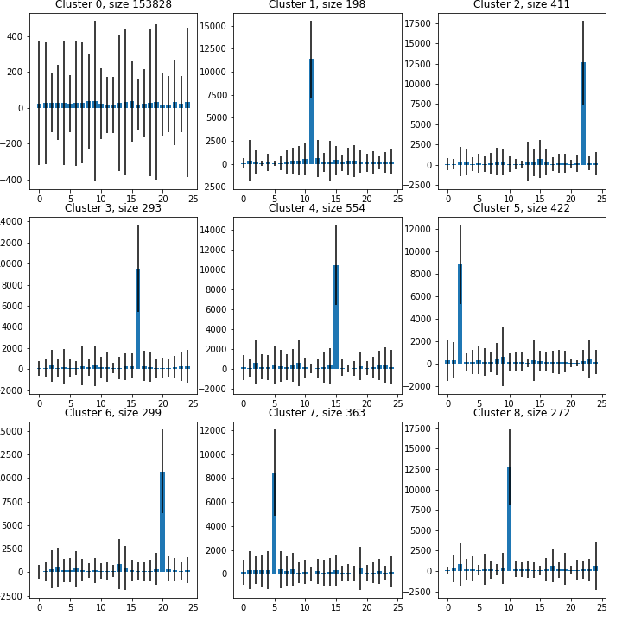
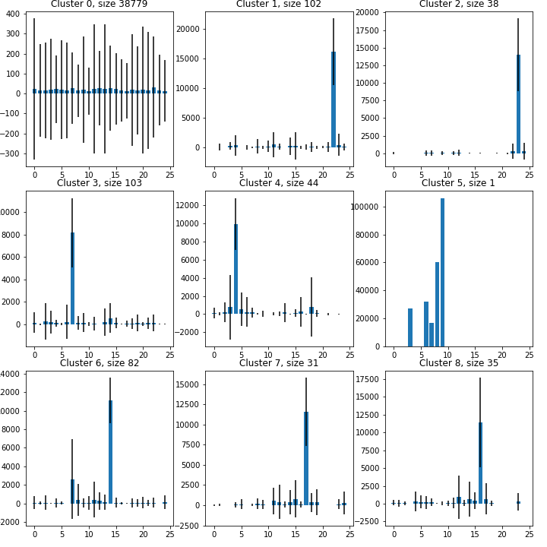
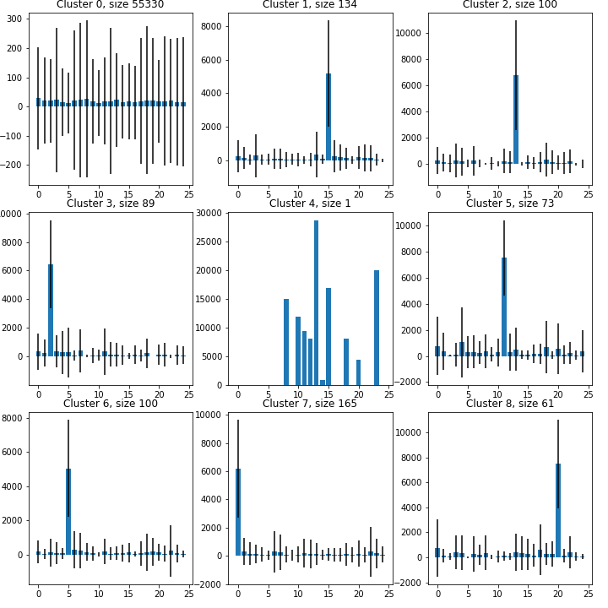
Player Purchase Data Clustering on DOTS for Lucky Draw, Item Shop, Crate
Lucky Draw
Item Shop
Crate
In all 3 clusterings above, we see very little separation on which part of the season users are purchasing Lucky Draw, Item Shop, and Crate items. Cluster 0 captures almost all users in each of the clusters and represents purchases occurring (almost) uniformly throughout the season for most users.

Slide 29
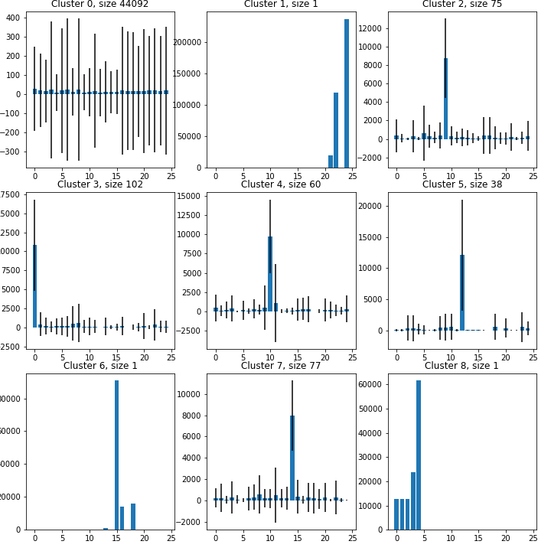
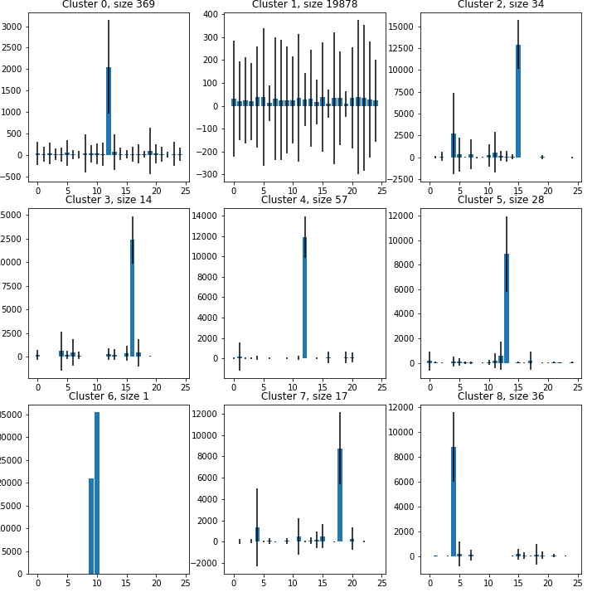
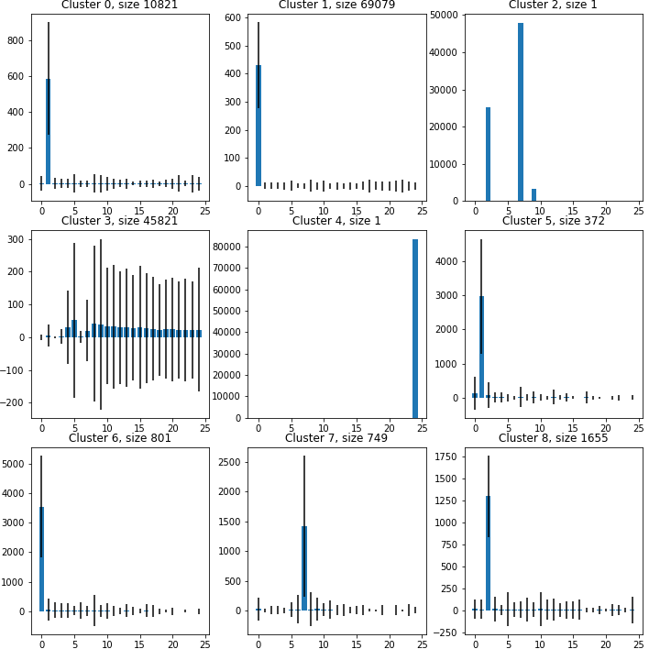
Player Purchase Data Clustering on DOTS for Just For You, Bundle, Battle Pass
Just For You
Bundle
Battle Pass
Similarly, we see little clustering success for DOTS on Just For You and Bundle items, being bought by most users uniformly throughout the season. Battle Pass clustering seems to agree with our hypothesis that those purchasing the Battle Pass would do so earlier in the season rather than later, but the large size of cluster 3 representing more uniform spending was unexpected and shows that some users are still purchasing the Battle Pass far into the season.

Slide 30
DOTW Clustering on Purchase Data

Slide 31
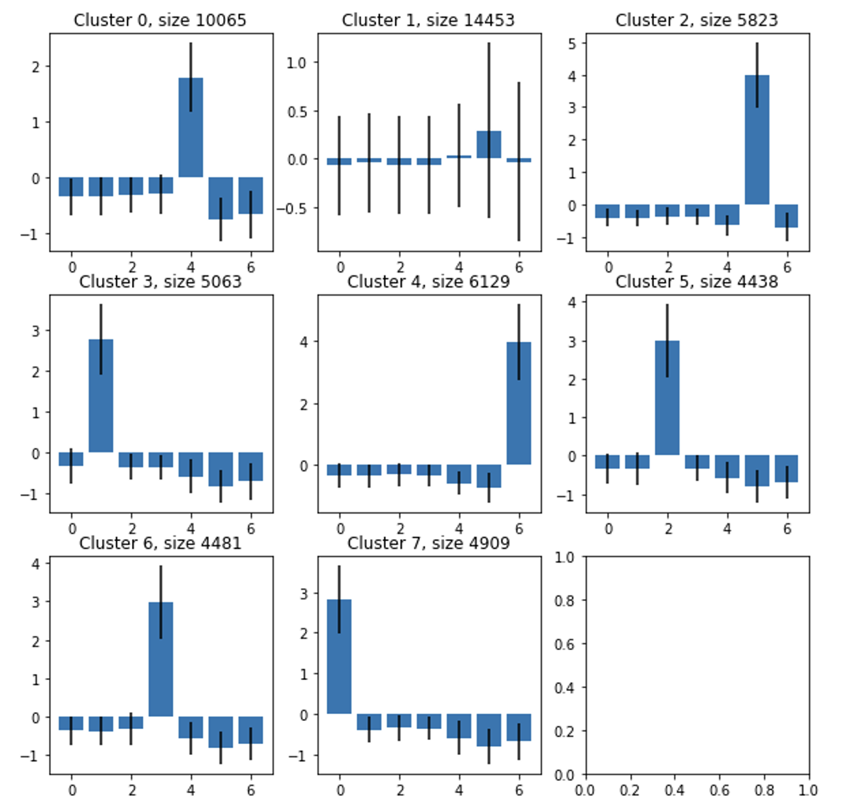
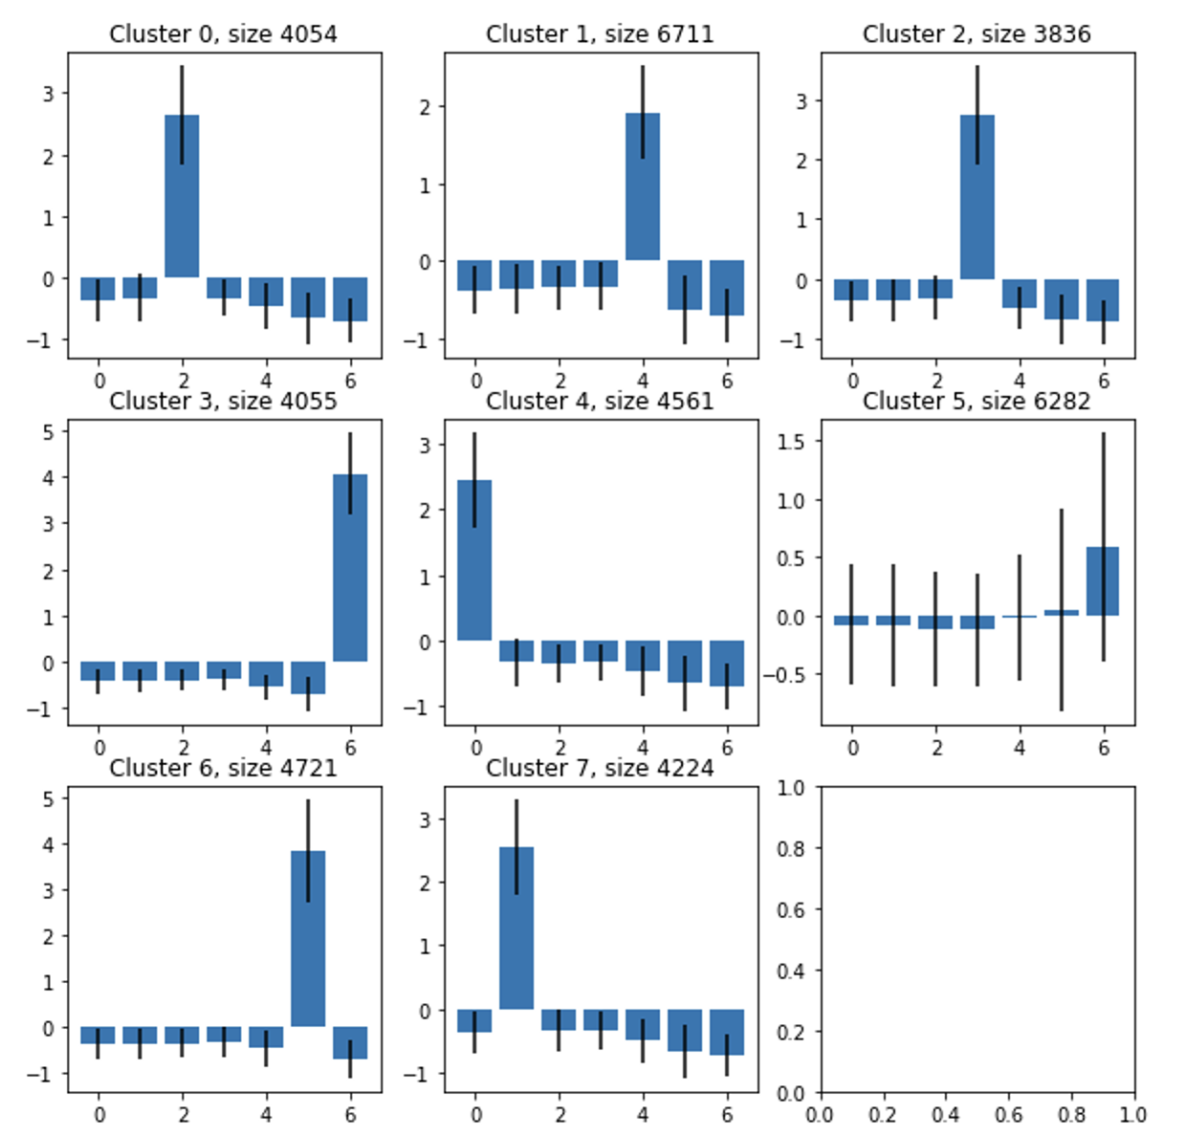
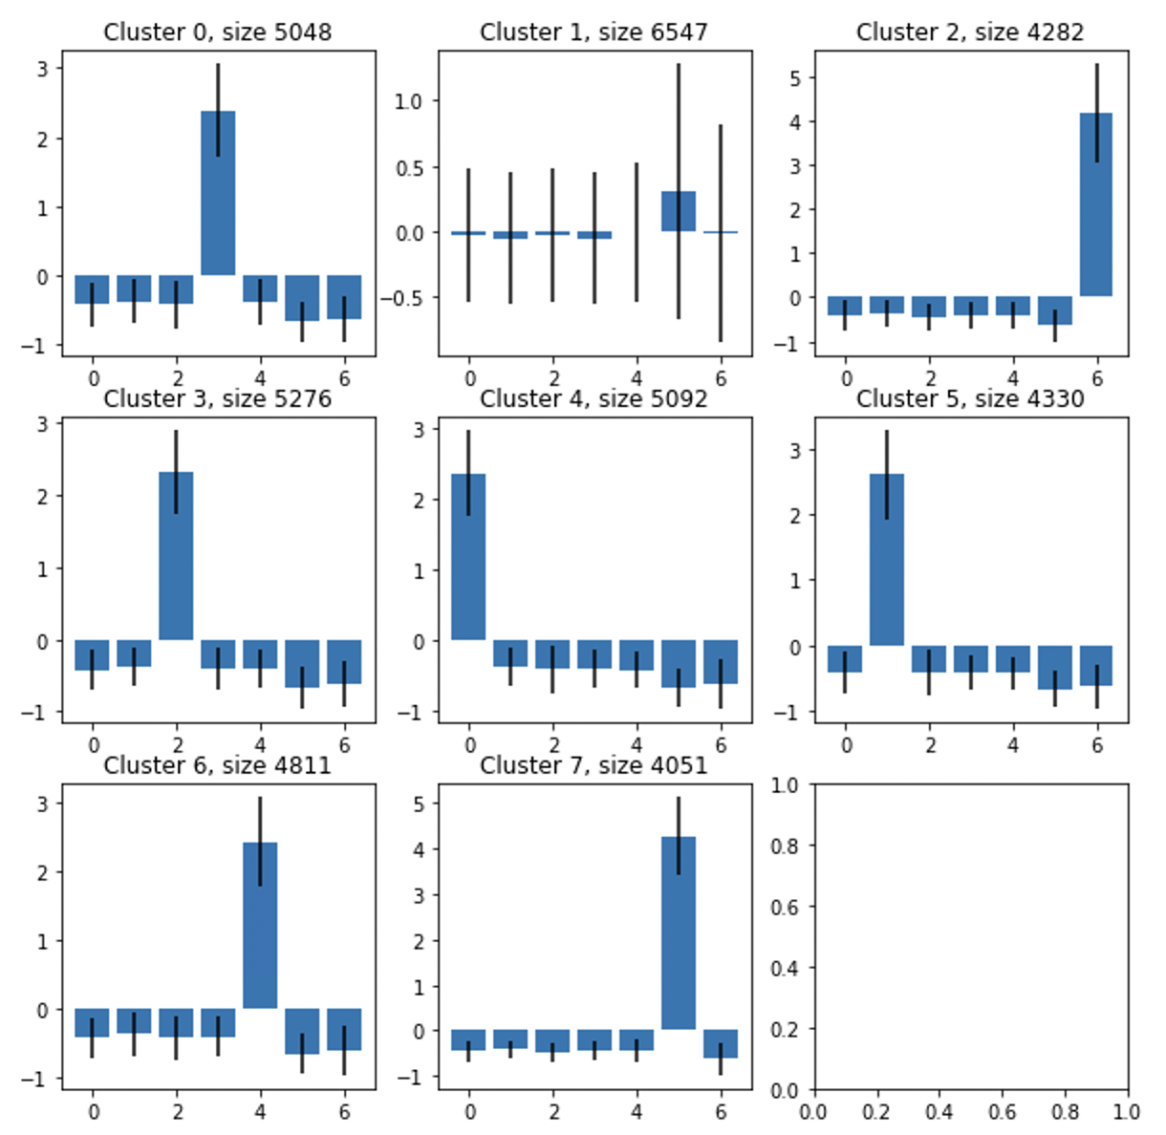
Player Purchase Data Clustering on DOTW for Lucky Draw, Item Shop, Crate
Lucky Draw
Item Shop
Crate
We see that DOTW clustering yields individual clusters for each day and an additional cluster for general purchasing throughout the week, which in Lucky Draw, Item Shop, and Crate reveals that purchasing these item types is skewed towards weekend purchases: on Saturday for Lucky Draw and Crate, and on Sunday for Item Shop.

Slide 32
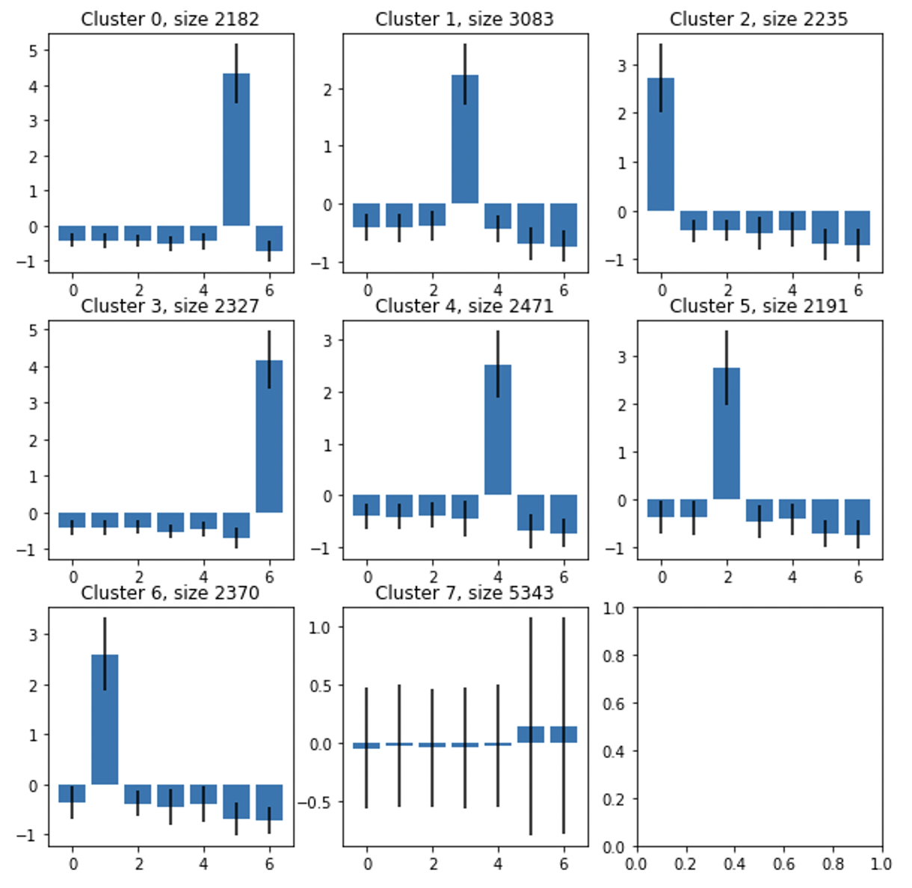
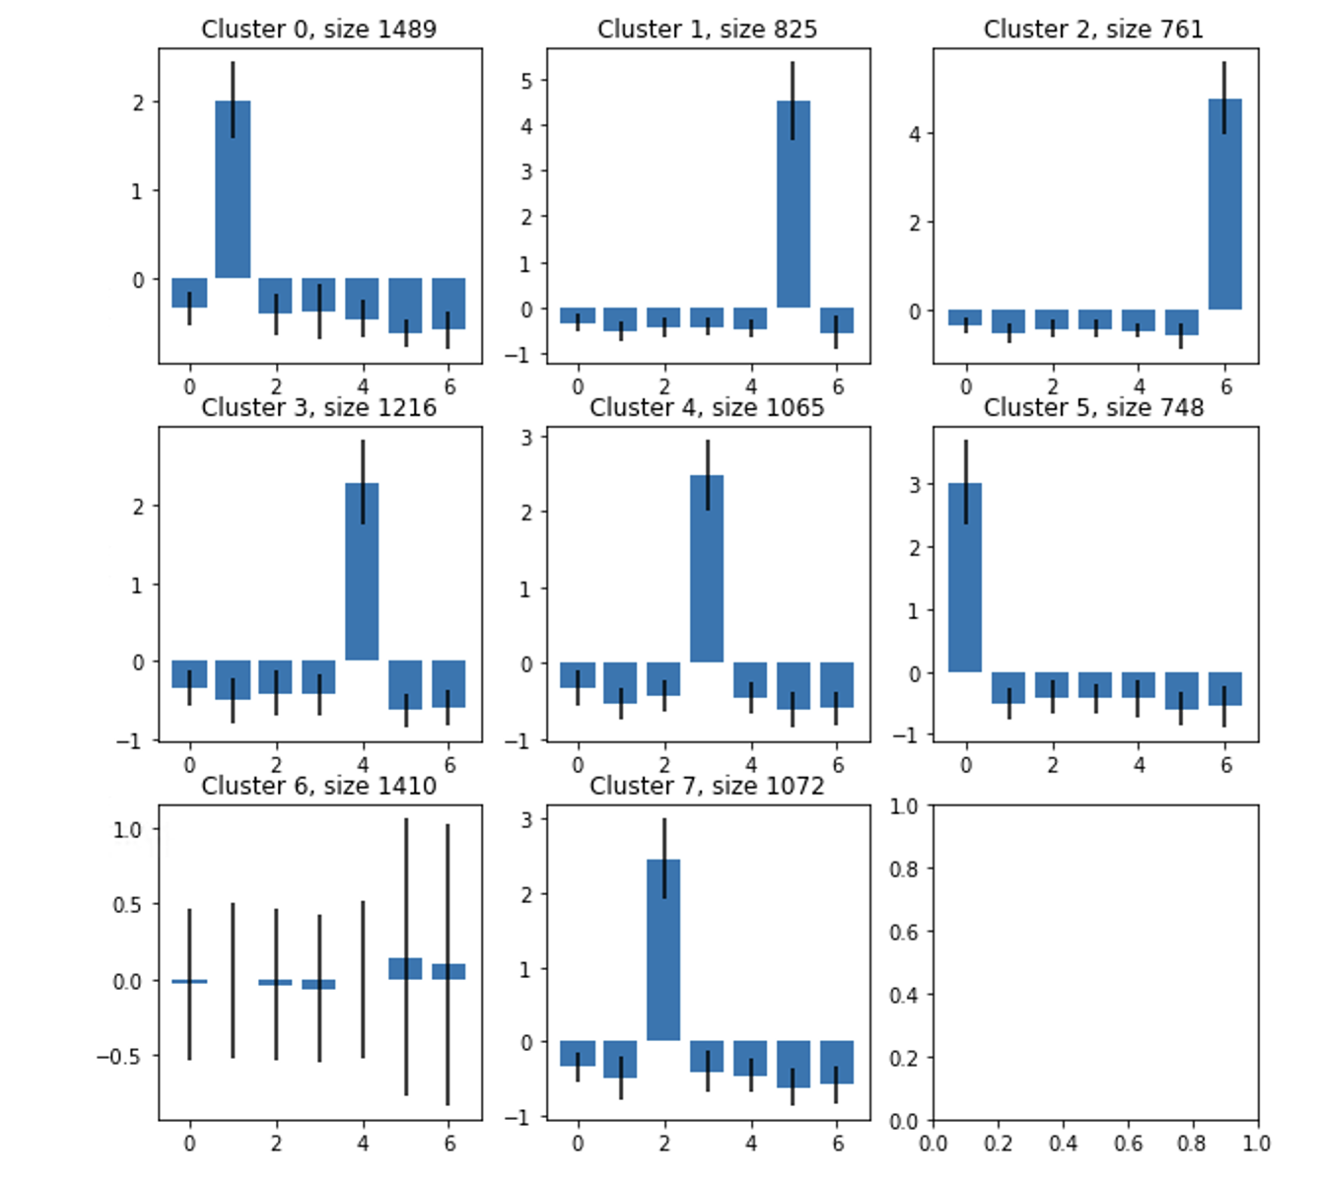
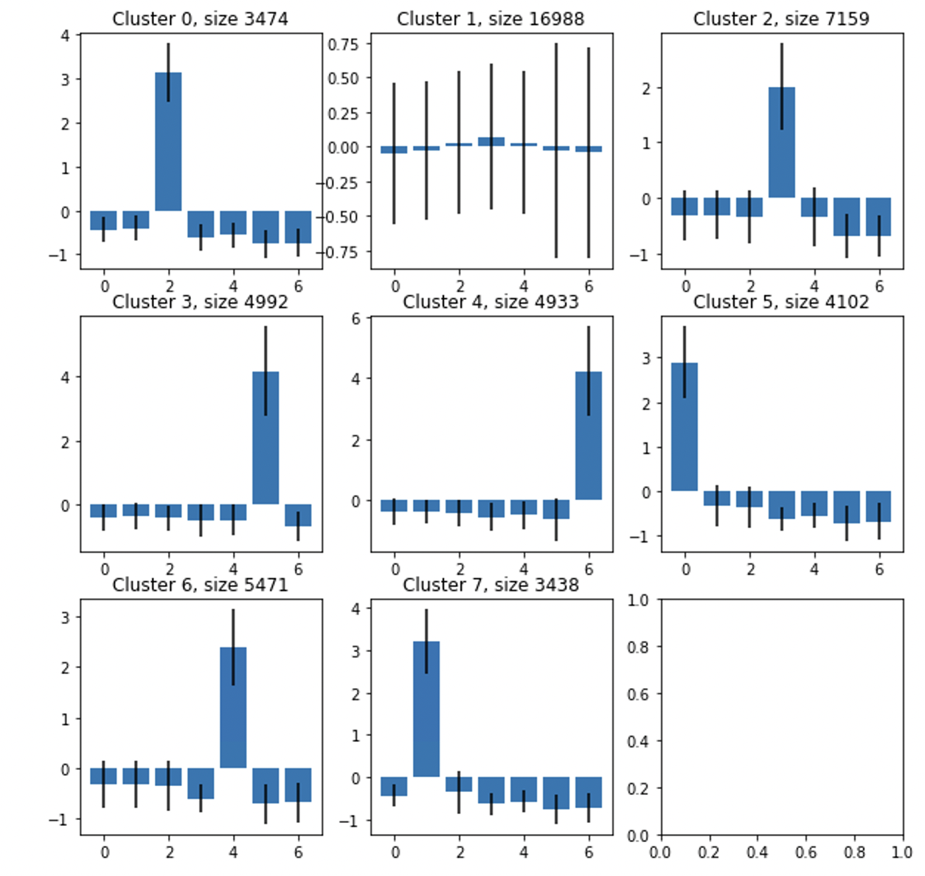
Player Purchase Data Clustering on DOTW for Just For You, Bundle, Battle Pass
Just For You
Bundle
Battle Pass
Similarly to the other item types, we see that clustering for Just For You, Bundle, and Battle Pass give clusters that represent each day alongside a general, non-day cluster. Just For You and Bundle have the same trend of the non-day cluster having more purchases on the weekend, but Battle Pass goes against this trend with the non-day cluster representing purchases on Thursday, potentially reflecting the beginning of seasons since Battle Pass is most bought on the first day.

Slide 33
Aggregate Daily Match Wins for each Cluster of Users
Skilled Players tend to play on Tuesday and are likely to purchase crate and lucky draw items.
 |  | Total Daily Match Wins (October 2019 - February 2022)
 |  | Day of the Week
 |  | Monday | Tuesday | Wednesday | Thursday | Friday | Saturday | Sunday | Additional Cluster 7
Item for Purchase | Lucky Draw | 4,130,715 | 6,229,951 | 2,623,606 | 2,158,712 | 2,675,516 | 1,812,955 | 2,049,415 | 2,050,970
 | Battle Pass | 559,308 | 16,182,380 | 2,506,951 | 870,666 | 807,621 | 719,073 | 1,257,654 | 522,218
 | Item Shop | 1,837,952 | 3,159,463 | 1,833,242 | 1,867,525 | 2,056,203 | 2,914,221 | 2,166,121 | 1,975,398
 | Crate | 2,397,434 | 3,029,138 | 2,124,391 | 2,431,384 | 2,491,956 | 1,909,687 | 2,156,167 | 1,884,512
 | Just For You | 1,409,074 | 2,027,304 | 1,448,972 | 1,543,804 | 1,655,017 | 1,466,454 | 1,461,366 | 3,573,134
 | Bundle | 1,483,237 | 618,113 | 495,812 | 1,189,407 | 786,947 | 544,494 | 2,592,803 | 796,107

Slide 34
Aggregate Daily Match Hours Played for each Cluster of Users
Comparing Daily Match Hours to Daily Match wins show the same patterns: skilled Players generally play on Tuesday and are likely to purchase crate and lucky draw items.
 |  | Total Daily Match Hours (October 2019 - February 2022)
 |  | Day of the Week
 |  | Monday | Tuesday | Wednesday | Thursday | Friday | Saturday | Sunday | Additional Cluster 7
Item for Purchase | Lucky Draw | 972,446 | 1,445,184 | 602,968 | 521,312 | 628,699 | 418,127 | 479,424 | 479,627
 | Battle Pass | 110,214 | 3,861,346 | 619,433 | 199,249 | 173,601 | 150,474 | 286,374 | 113,479
 | Item Shop | 416,263 | 705,296 | 403,565 | 435,001 | 467,319 | 677,651 | 515,343 | 463,664
 | Crate | 551,968 | 716,119 | 504,641 | 571,433 | 592,078 | 452,736 | 521,673 | 431,392
 | Just For You | 327,048 | 488,956 | 355,538 | 378,442 | 399,878 | 358,294 | 361,202 | 877,026
 | Bundle | 354,308 | 140,785 | 120,871 | 293,934 | 187,415 | 132,730 | 615,776 | 196,786

Slide 35
Aggregate Revenue (USD) for each Cluster of Users
Comparing Daily Match Wins to Total Revenues show the same patterns: skilled Players tend to play on Tuesday and are likely to purchase crate and lucky draw items.
 |  | Total Daily Revenue USD (October 2019 - February 2022)
 |  | Day of the Week
 |  | Monday | Tuesday | Wednesday | Thursday | Friday | Saturday | Sunday | Additional Cluster 7
Item for Purchase | Lucky Draw | $357,454.05 | $561,732.23 | $225,685.39 | $205,737.27 | $293,926.04 | $182,296.86 | $182,953.30 | $187,077.05
 | Battle Pass | $27,527.74 | $1,842,408.00 | $115,050.85 | $47,166.10 | $53,636.09 | $53,089.60 | $81,790.08 | $29,178.74
 | Item Shop | $201,010.72 | $339,570.04 | $217,606.81 | $188,398.64 | $228,153.30 | $319,512.71 | $240,210.91 | $218,768.46
 | Crate | $256,494.89 | $316,214.40 | $193,024.20 | $278,764.50 | $271,021.20 | $246,381.93 | $228,303.75 | $210,480.57
 | Just For You | $149,652.61 | $219,235.10 | $159,427.43 | $226,598.00 | $200,037.95 | $174,901.02 | $171,012.53 | $445,069.93
 | Bundle | $199,117.07 | $70,679.37 | $51,146.51 | $173,163.62 | $78,556.87 | $74,184.42 | $879,905.76 | $110,115.16

Slide 36
Key Takeaways

Slide 37
Key Takeaways (pt. 1)
What can we extrapolate about player behavior from these clusters? How can Activision use these clusters?
fPCA showed the presence of a power cluster of ~15% of the userbase that generates over ~80% of the revenue
In the DOTW clusters, the two more consistent play clusters showed the highest revenue. The two weekend clusters also have higher revenue here, presenting potential for higher spending on weekends.
In the game mode breakdown, we see players increasingly playing MPR, indicating potential climbers.
Highest revenue clusters correspond to higher playtime in ranked modes.
The players who play consistently throughout the year but don’t play many hours per day usually play more near the end of a season.
Players who play consistently throughout the year and log a high average hours/day play more near the beginning of a season.

Slide 38
Key Takeaways (pt. 2)
What can we extrapolate about player behavior from these clusters? How can Activision use these clusters?
Lucky Draw is the most popular item with close to half the transactions and around 40% of total revenue.
Surprisingly, groups buy Battle Pass throughout a season in addition to at the start.
Players buy Lucky Draw, Crate, and Item Shop more on weekends.
Battle Pass purchases are skewed towards Thursdays, potentially because of the start of the season.
Skilled Players tend to play on Tuesday and are likely to purchase Crate and Lucky Draw items.

Slide 39
Questions?

